Slide 1
Path planning algorithm for semi-autonomous mobile robots with fast and accurate collision checking
Final Master's Thesis Presentation
Kevin Denis
Supervisor : Prof. dr. ir. E. Demeester
Supervisor : Prof. dr. ir. H. Bruyninckx
Mentor : Dr. J. Philips
Notes:
Welcome to my master’s thesis presentation on “Path planning algorithm for semi-autonomous mobile robots with fast and accurate collision checking”.

Slide 2
Agenda
Introduction
Design of a Local Path Planner
Evaluation of the Developed Local Path Planner
Extension for Dynamic Obstacles
Socially Compliant Path Planning
Future Work and Conclusion
Notes:
Overview of what I’m going to address during this presentation.
Start with a small introduction giving the context, scope and contributions of my work
Then explain the design steps of the LPP which I developed, followed by an evaluation
Conceptual solution to include the effect of moving obstacles in the calculation of the collision free paths
Introduce the topic of human-aware robot navigation, and provide guidelines to obtain a more socially compliant path planner
End presentation with possible future work on this subject and concluding remark

Slide 3
Agenda
Introduction
Design of a Local Path Planner
Evaluation of the Developed Local Path Planner
Extension for Dynamic Obstacles
Socially Compliant Path Planning
Future Work and Conclusion
Notes:
Let’s start with the introduction

Slide 4
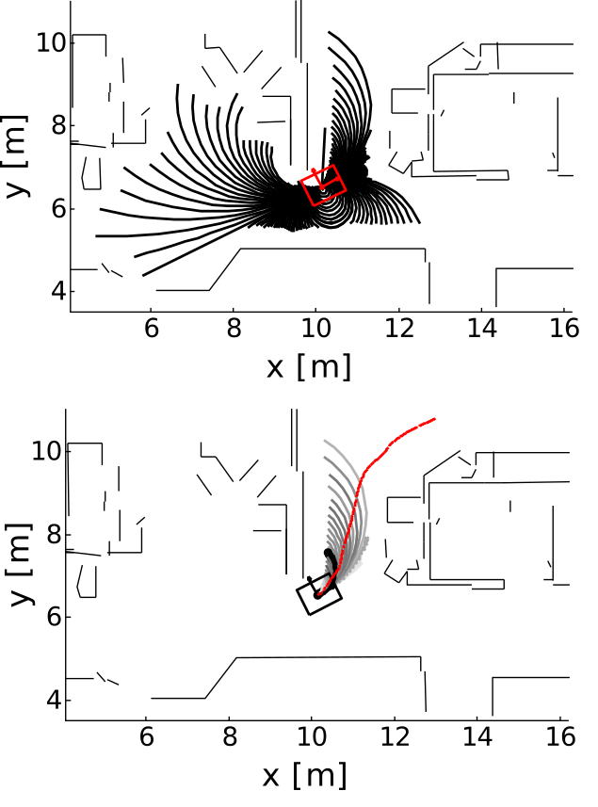
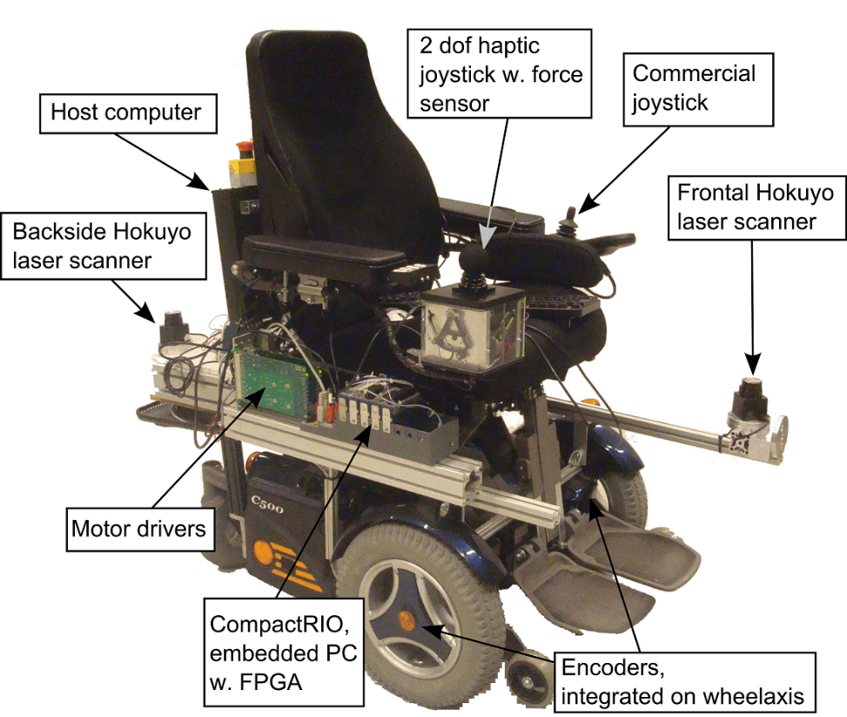
Introduction
Semi Autonomous Mobile Robot
(Local) Path Planning Algorithm
Introduction
Notes:
2 important parts in my masters' thesis title:
Semi-autonomous Mobile Robot, which reflects on the fact that my case study will be the Navigation Assistance for an electric wheelchair → ROBOT
(Local) Path Planning Algorithm, which indicates that I will focus my study on the on that specific part
The Department of Mechanical Engineering has already made large contributions to the domain Wheelchair Navigation Assistance
through various projects
Example of a commercially available wheelchair upgraded with Navigation Assistance Technology.
The domain of Wheelchair Navigation Assistance can be divided 3 main research areas
Asses of the navigation intention of the driver, who as shown on this picture, a joystick to control the wheelchair
The Generation of a local set of paths, (SAFE AND CAN PERFORMED BY WHEELCHAIRE)
Haptic feedback for shared control, needed for a better interaction between the driver and the wheelchair.
The top-right figure shows the generation of a set of local paths, which will be the focus of my thesis. These collision-free trajectories will serve to model the user intention.
This step is shown on the bottom-right figure, we see in RED the path the user will take. The start of the THICK BLACK path corresponds the best LOCALLY to the user’s intention. This is continually updated and changed from the moment this path doesn’t correspond anymore to the users intention

Slide 5
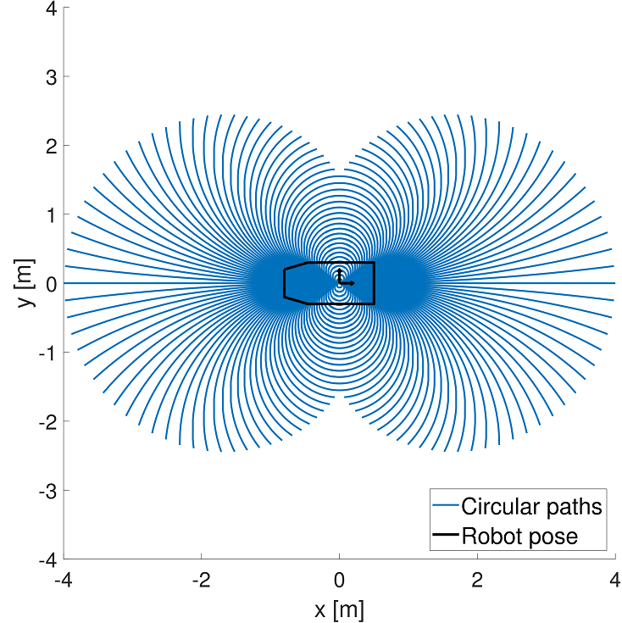
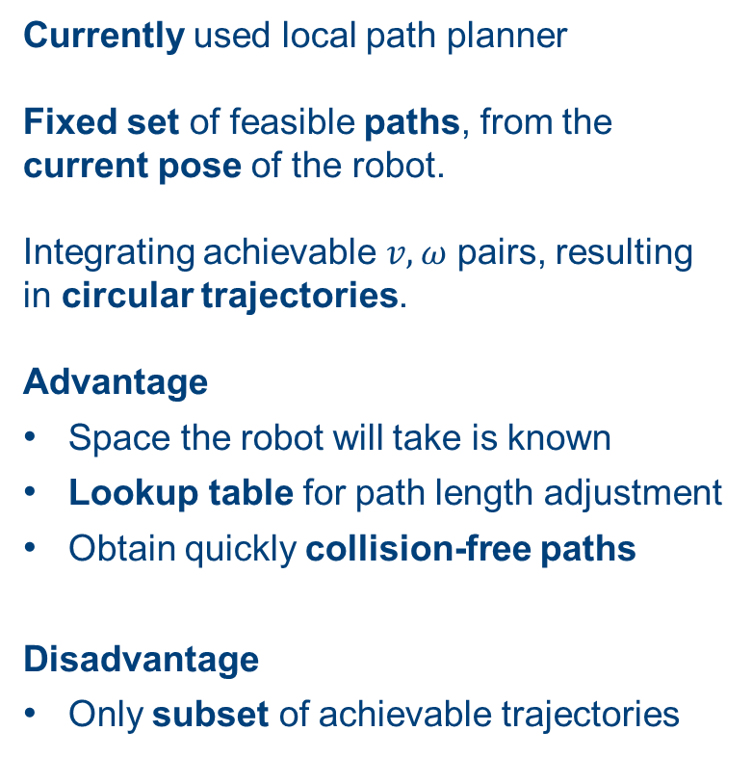
Circular Local Path Template
Currently used local path planner Fixed set of feasible paths, from the current pose of the robot. Integrating achievable $v,ω$ pairs, resulting in circular trajectories. Advantage
Space the robot will take is known
Lookup table for path length adjustment
Obtain quickly collision-free paths
Disadvantage
Only subset of achievable trajectories
Introduction
Notes:
The path planner is based on the Local Path Template method, developed by prof. Demeester.
This method uses a fixed set of kinematically feasible paths, originating from the current pose of the robot
The current trajectories are based on circular arcs, obtained by integrating achievable linear and angular speeds.
This is why I will consequently call this the Circular LPT method
ADVANTAGE
When using a fixed set of paths, one can calculate in advance the space the wheelchair will take when taking each path
By storing this in an precomputed lookup table, each path can be quickly adjusted, given a certain environment, to become collision free, and offer safe paths to be used as model for the user’s intention
Disadvantage
Since it is not feasible to include all feasible trajectories, certain choses have to be made, resulting in a small subset of paths.

Slide 6
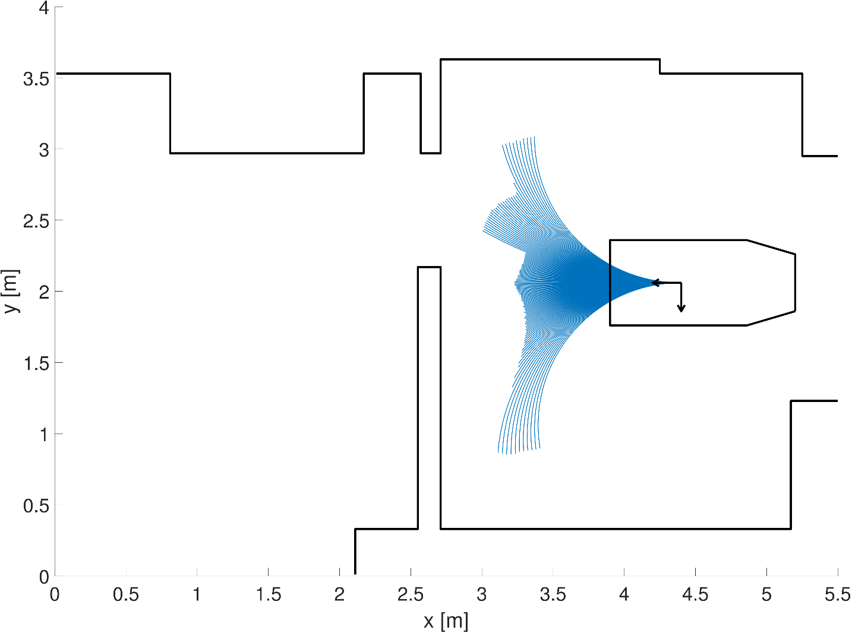
Circular Local Path Template
Introduction
Notes:
There is a certain lack of flexibility when only employing circular curves to calculate collision-free trajectories.
When the wheelchair has to pass through a narrow space, from an unfavourable pose the LPT does not find a path going through the doorway.
This limits the assistance provided to the user.

Slide 7
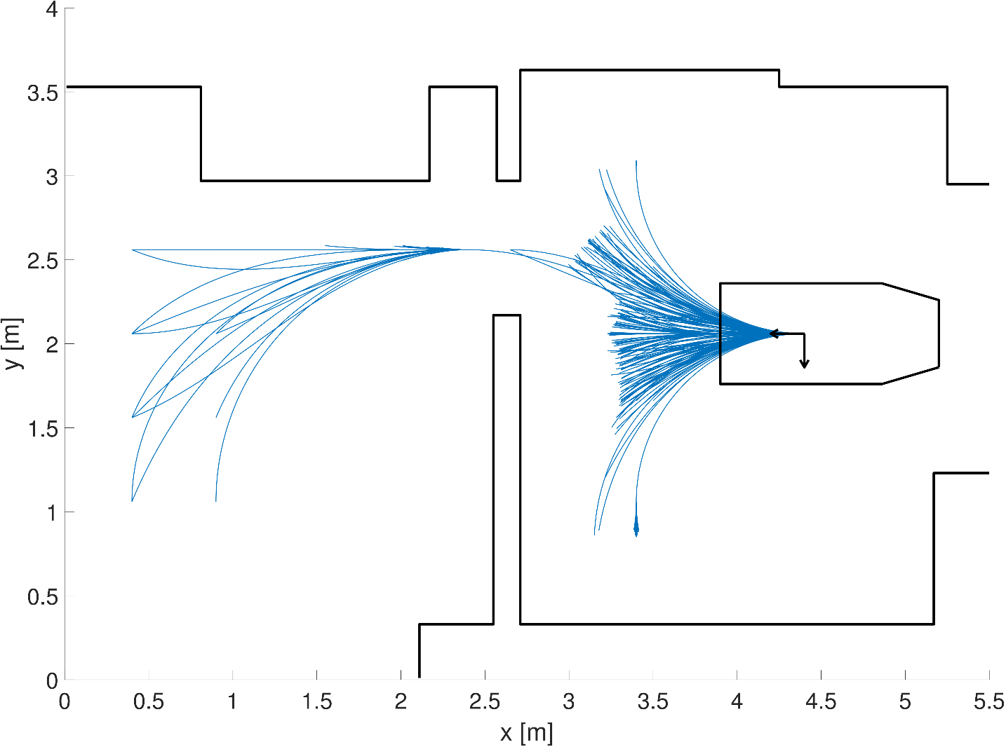
Clothoidal Local Path Template
Introduction
Notes:
This thesis will expand the set of feasible motions by using a more complex curve geometry, able to find a path in this situation.
Since the new curve geometry will be based on clothoids, I will call the developed planner in this thesis the Clothoidal Local Path Template

Slide 8
Scope and Contribution
Expand the set of feasible motions by using a more complex curve geometry, offering better assistance to the user. Conceptual solution taking dynamic obstacles into account, by finding an optimal speed profile for each path. Guidelines to obtain a socially compliant path planner and explicitly takes into account the cooperation of surrounding persons.
Introduction
Notes:
This thesis will contribute to the research on navigation assistance by :
Using a more complex curve geometry offering a higher flexibility to the user and better assistance when performing a complex maneuver.
A conceptual solution will be presented to address planning a path with moving obstacles, calculating an optimal speed profile when taken a particular path.
I will provide guidelines to obtain a socially compliant path planner which could result in a more comfortable navigation for the surrounding persons.
I will also present a state of the art model with anticipates cooperation of the interacting persons, making in possible for the wheelchair to navigate in dense human crowds.

Slide 9
Agenda
Introduction
Design of a Local Path Planner
Evaluation of the Developed Local Path Planner
Extension for Dynamic Obstacles
Socially Compliant Path Planning
Future Work and Conclusion
Notes:
This part will give an overview of the different design steps of the developed planner : the clothoidal Local Path Template.

Slide 10
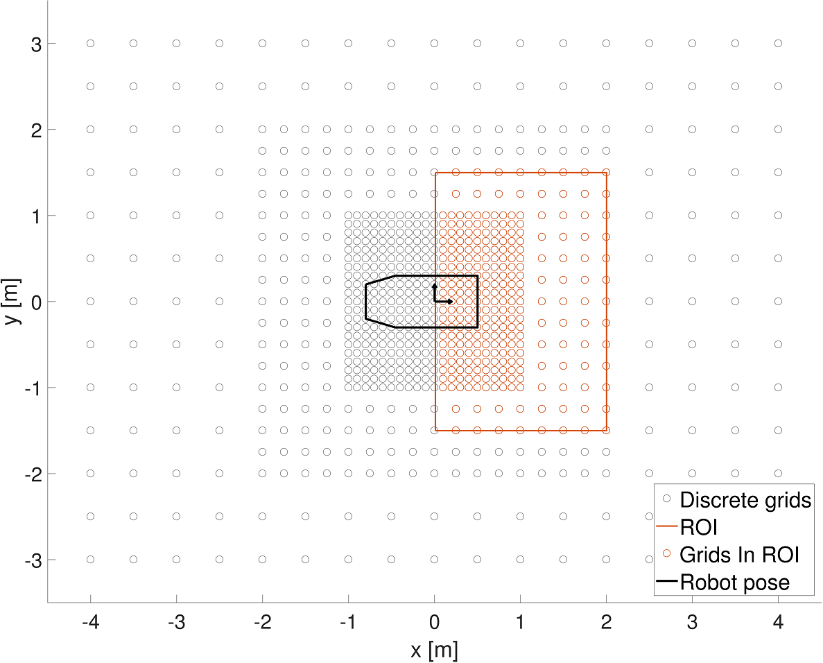
Multi-Size Grid and Region Of Interest
Sampling the reachable space surrounding the robot.
3 different sample sizes, dependent on the distance to the origin.
Goal: limit the numbers of paths leading to a relatively similar end pose.
Region Of Interest defines the grid cells which will be connected with the selected geometrical curve.
Design of a Local Path Planner
Notes:
In stead of following the forward generation method by integrating achievable velocities, adopt the inverse generation method will be applied
First, the environment is sampled using a multi size grid
The parameters defining those grid can be fine-tuned depending on the application
Doing this will limit the number of paths leading to a pose with is relatively the same compared to the origin.
A region of interest is defined, which selects possible end poses of this multi sized grid which will be connected with the selected geometrical curve, the clothoid

Slide 11
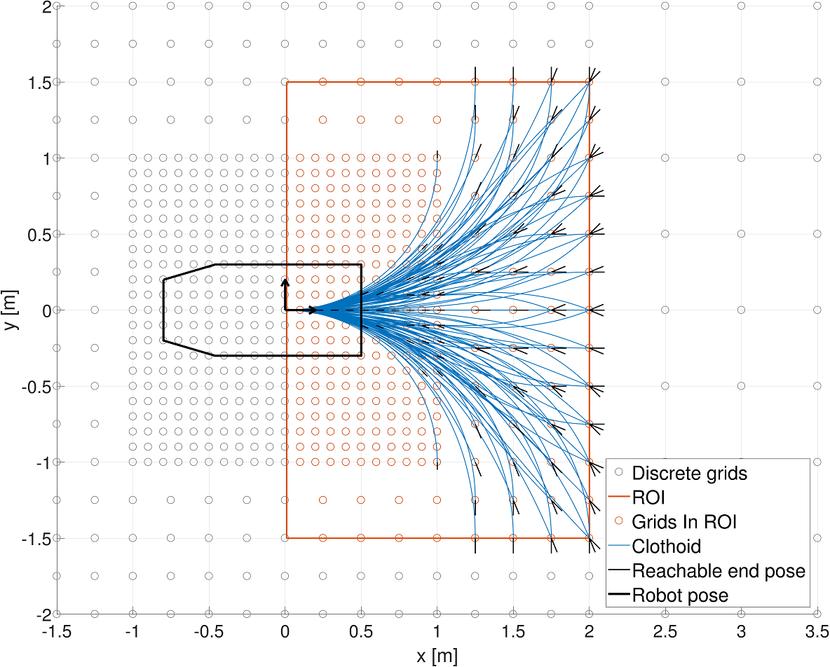
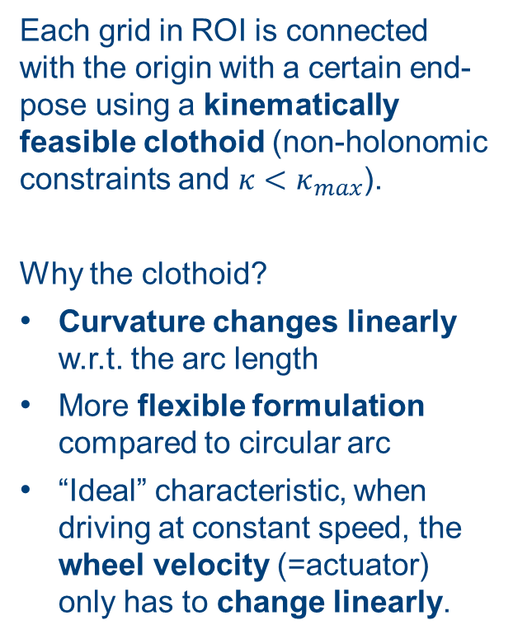
Selected curve geometry: clothoid
Each grid in ROI is connected with the origin with a certain end-pose using a kinematically feasible clothoid (non-holonomic constraints and $κ<κ_{max}$).
Why the clothoid?
Curvature changes linearly w.r.t. the arc length
More flexible formulation compared to circular arc
“Ideal” characteristic, when driving at constant speed, the wheel velocity (=actuator) only has to change linearly.
Design of a Local Path Planner
Notes:
Each grid cell is connected with the origin at a certain end-orientation with the selected curve geometry: the clothoid.
Only feasible connections are added to the set of fixed paths, respecting the kinematic constraints of the wheelchair (non-holonomic constraints and maximum allowed curvature (for paths comfortable to the user at nominal velocity).
RAILWAY AND HIGHWAY
The characteristic of a clothoid is that it’s curvature changes linearly with respect to the arc length.
This feature results in an ideal control action when driving at constant speed, since the wheel velocity only has to change linearly, which makes the trajectory easier to follow.

Slide 12
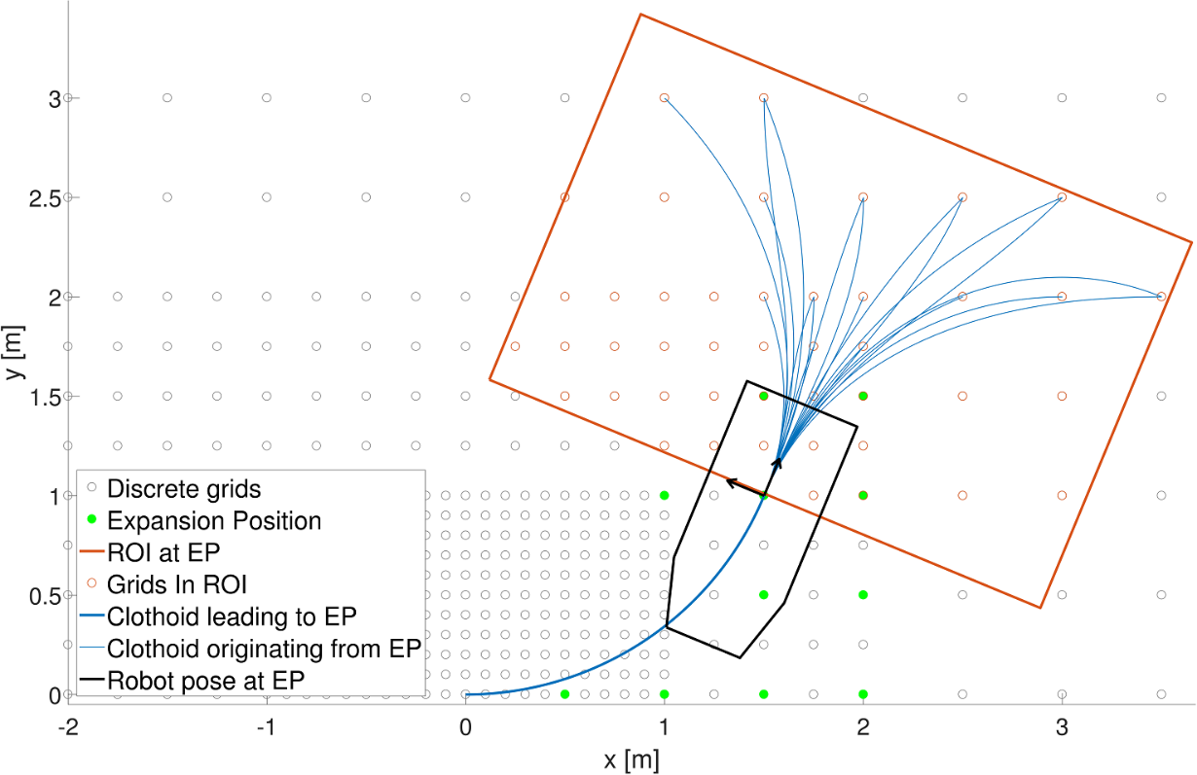
Expansion Positions
Larger variety of local paths obtained by repeating previous steps at different Expansion Positions.
Design of a Local Path Planner
Notes:
In order to create a larger variety of paths, certain trajectories will consists of two clothoids.
EXPANTION POSITION : GREEN
This is done by repeating the previous procedure at feasible end poses and drawing the ROI at that end pose as you can see on this figure.
Now, feasible connections are made with pose of the robot at the expansion position, not the origin !

Slide 13
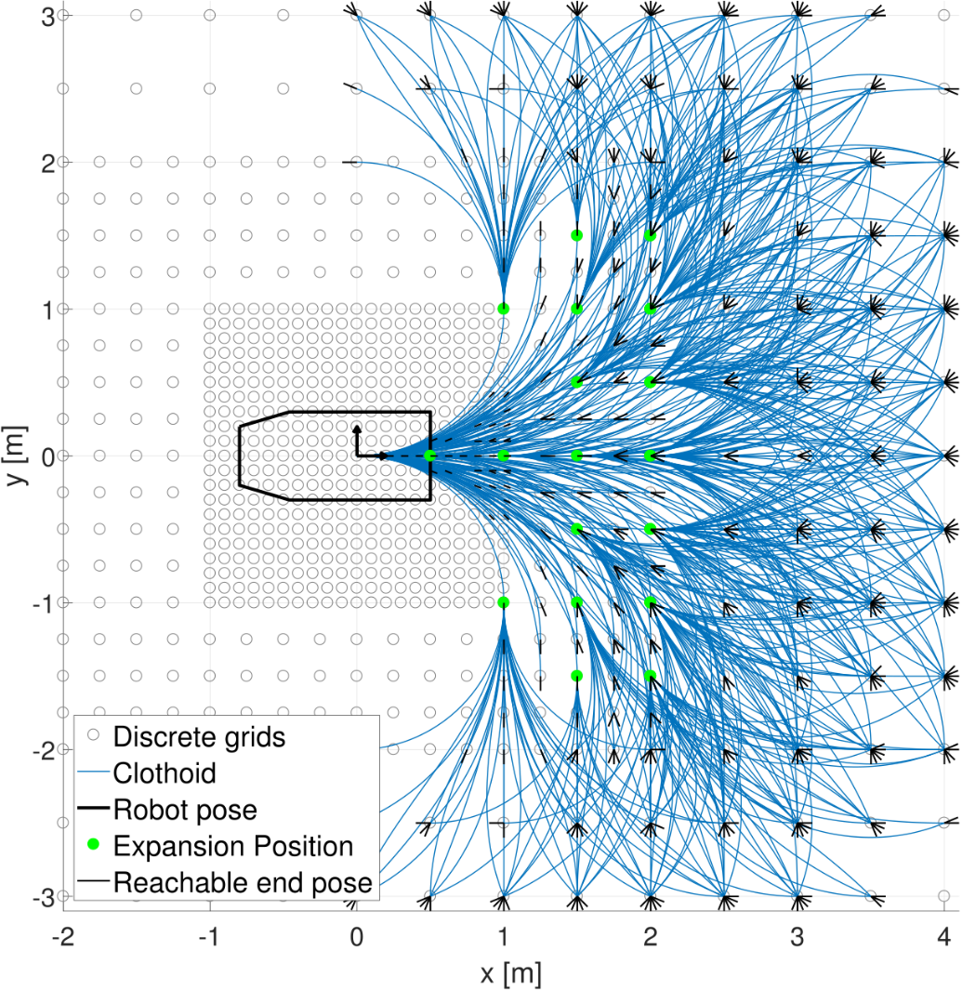
Fixed set of trajectories based on Clothoids
Design of a Local Path Planner
Notes:
By repeating this procedure we obtain the full set of trajectories of the local path template.
The next step is to create the lookup table which will enable the planner to quickly asses whether a path is collision-free.

Slide 14
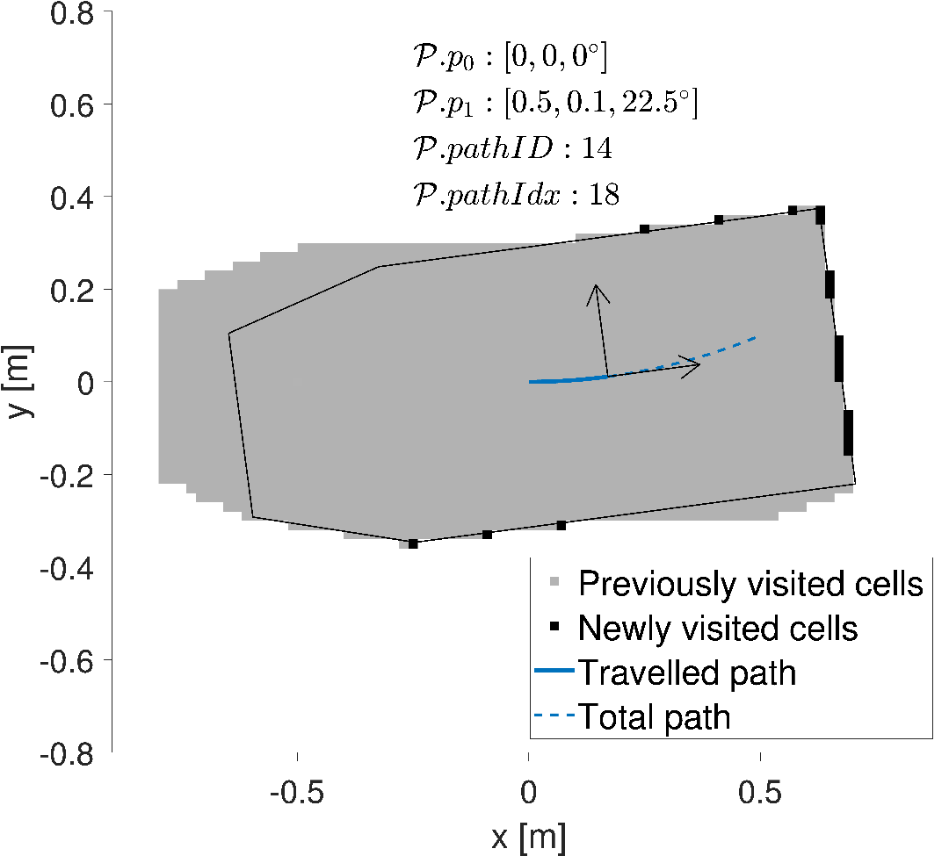
Precomputed lookup table for fast collision checking
Precompute space the wheelchair occupies when taking each path. Structure lookup table optimized, each occupied cell contains:
Which path the robot took when going trough it
Its corresponding path length
Online phase: Matching the occupied grid cells in the environment with cells from the lookup table
Design of a Local Path Planner
Notes:
The first step in the creation of the lookup table is to simulate the footprint of the wheelchair going over each path of the template.
As the wheelchair advances over the path, newly visited cells are marked, along with the path Identification and corresponding length.
Previously visited cells are marked in grey, and newly visited cells in black on this figure.
The structure of the lookup table itself can be optimized.
Instead of building the lookup table based on each path, it can be build based on all the cells occupied by the robot.
In this case, cells occupied by the robot when taking each path of the LPT contain
which path the robot took to occupy this particular cell and
its corresponding path length.
The online phase will then consist of matching the occupied grid cells in the environment with cells from the lookup table.
This method of creating the lookup table is the same as was used in the circular LPT

Slide 15
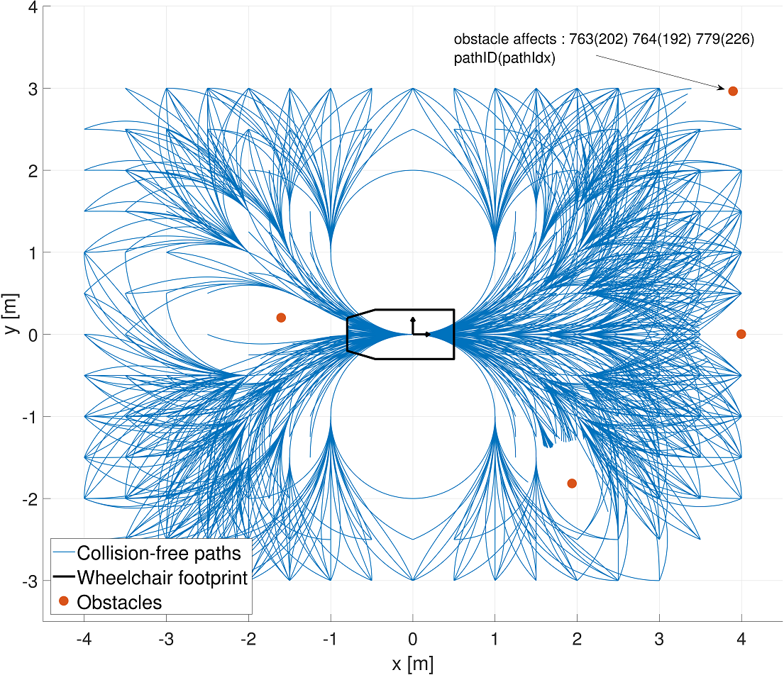
Clothoidal Local Path Template
Design of a Local Path Planner
Notes:
This is a small example on how individual obstacles affects the whole LPT
Each obstacle, although inflated, corresponds to 1 occupied grid cell
Therefore, this corresponds literally to the information available in the lookup table.
The obstacle at the top right end of the figure affects therefore 3 paths, at a certain length defined by an row index shown in parentheses

Slide 16
Agenda
Introduction
Design of a Local Path Planner
Evaluation of the Developed Local Path Planner
Extension for Dynamic Obstacles
Socially Compliant Path Planning
Future Work and Conclusion
Notes:
The developed clothoidal local path planner will now be evaluated by comparing it to it’s predecessor, the circular Local Path Template.
Two important criteria will be addressed
The first one will be the path planning performances and the second the execution time needed to adjust each path length.

Slide 17
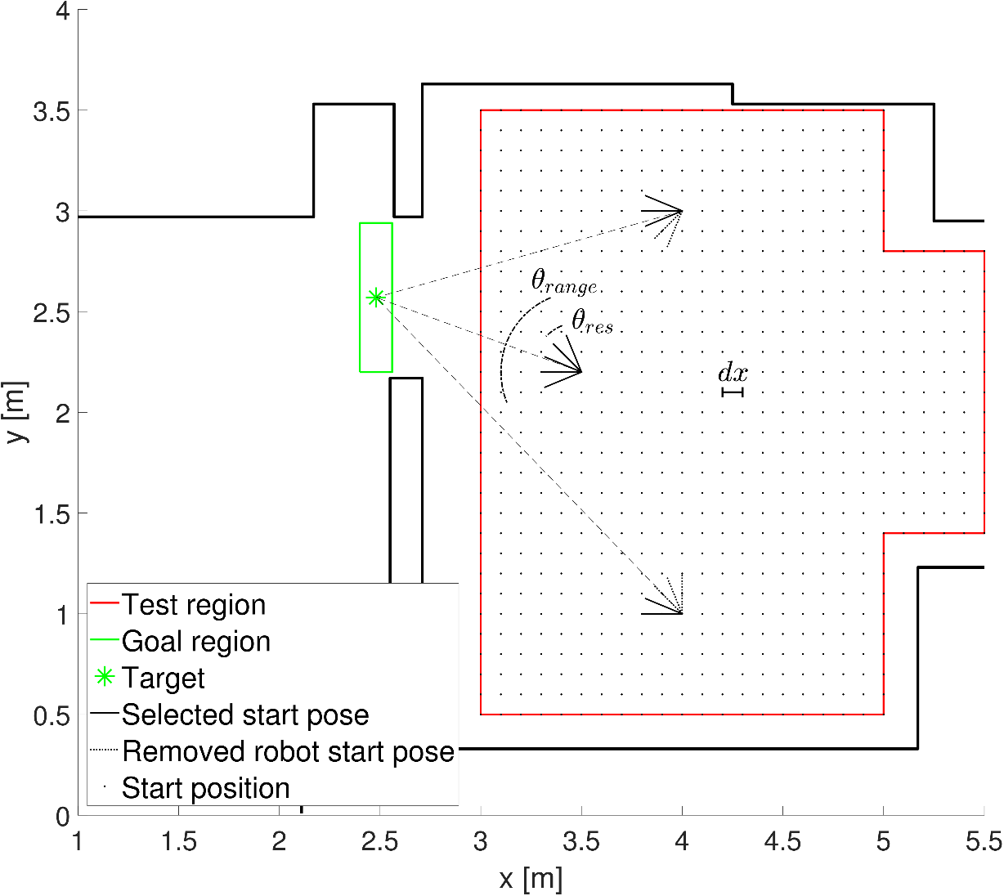
Path Planning Performance
Two scenario’s :
Forward driving trough a doorway
Backwards driving in an elevator
A uniformly distributed set of start poses is created.
Each LPT is positioned on the different start poses. Successful if it achieves to plan a path trough the goal region. 3 Cases : only circular, both and only clothoidal.
Evaluation of the Developed Local Path Planner
Notes:
Two scenarios will be used for the path planning criteria.
The first scenario will consist of driving forwards trough a door.
The second will be driving backwards in an elevator. This second scenario has been inspired by the research made in the department of mechanical engineering where the circular LPT has difficulties planning a path.
First, a uniformly set of start poses is created as can be seen on the figure. Start positions are equally spaced, and a range start orientations are added. The middle of this range of orientation is aligned with a target, but rounded up to the nearest multiple of angular resolution.
A LPT is considered to be successful if is able to plan one path going from the current start pose in the goal region. The number of paths is not taken into account.
There are 3 different cases for a specific start pose : it is only successful for the circular LPT, it is successful to both LPT’s or only successful for the clothoidal LPT

Slide 18
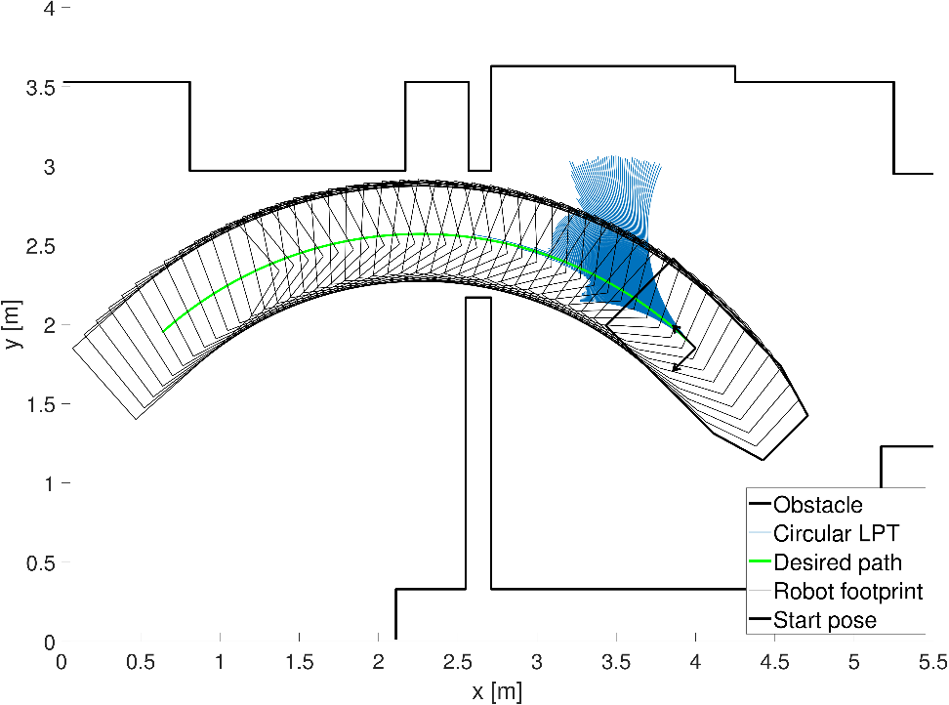
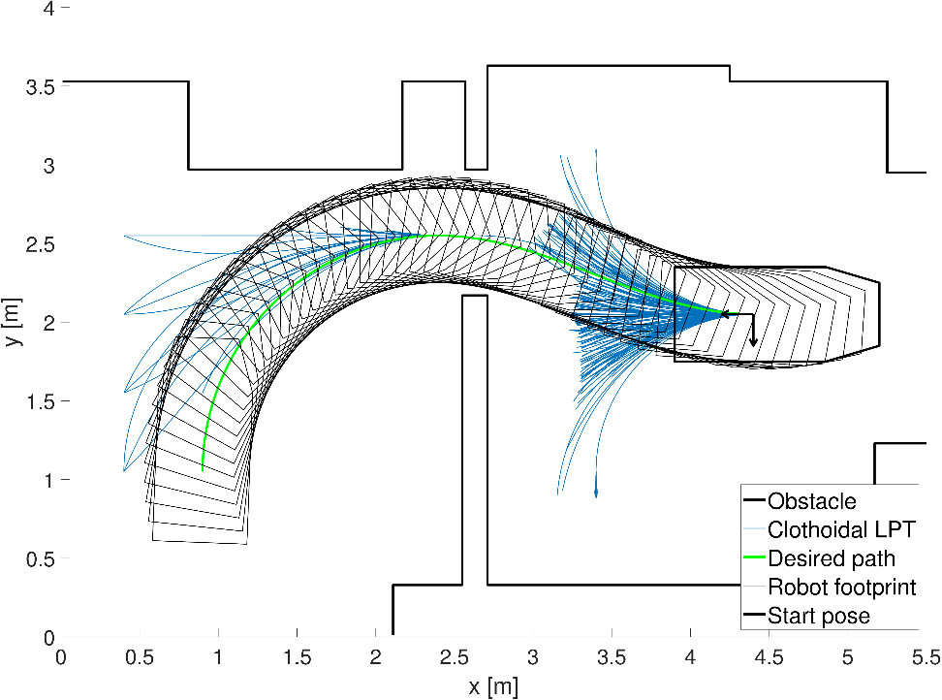
Path Planning Performance
Successful circular LPT
Successful clothoidal LPT
Evaluation of the Developed Local Path Planner
Notes:
First, we can visually inspect the collision-free nature of both LPTs by plotting the wheelchair geometry over a particular path.
On the left is displayed a successful start pose for the circular LPT and on the right a successful start pose for the clothoidal LPT.
Since there the plotted robot geometry doesn’t overlap with the environment, both paths are collision-free.

Slide 19
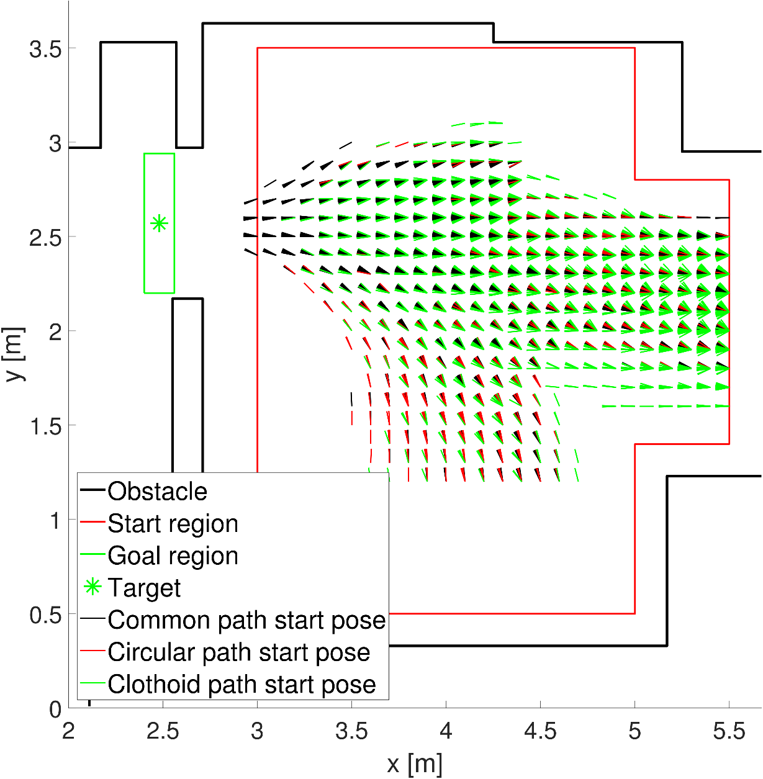
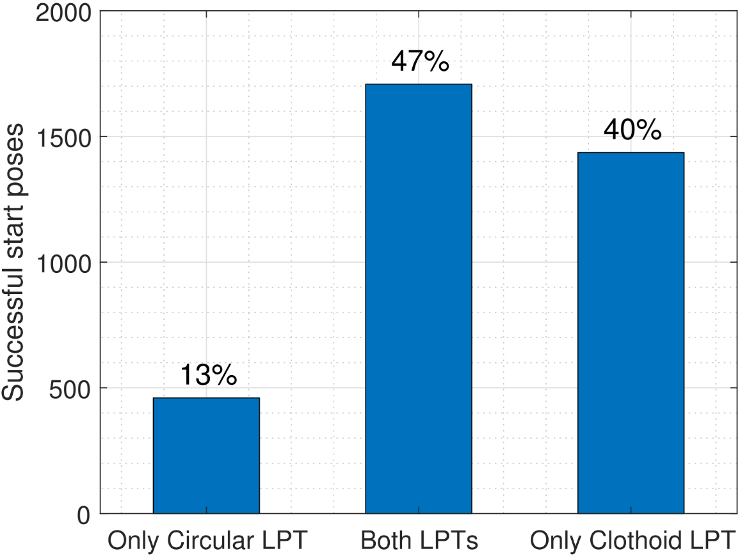
Path Planning Performances
Common start poses in front of the goal
Lower end favours the circular LPT From the moment a more complex path is needed, only the clothoidal LPT is successful Clothoidal LPT: 87% successful
Circular LPT: 60% successful
Evaluation of the Developed Local Path Planner
Notes:
Since straight paths are common to both LPTs, poses in front of the goal region
obtain the same result for the circular and clothoidal LPT.
The majority of the paths from start poses at the lower end of the figure
are achieved by the circular LPT. This is because those paths only require a
circular arc to enter the doorway. Since the circular LPT is composed of a
uniformly spread set of circular trajectories, this LPT is favored, compared to
the clothoidal LPT.
From the moment the required trajectory is more complex the clothoidal LPT is the only LPT able to plan a path.
When looking at the histogram, the majority (87%) of the poses
with a successful path are generated by the clothoidal LPT, which demonstrates
that for this first benchmark, the lack of uniformly spread circular trajectories
is not so crucial, as only 13% of the total amount of successful start poses are
uniquely found by using the circular LPT.

Slide 20
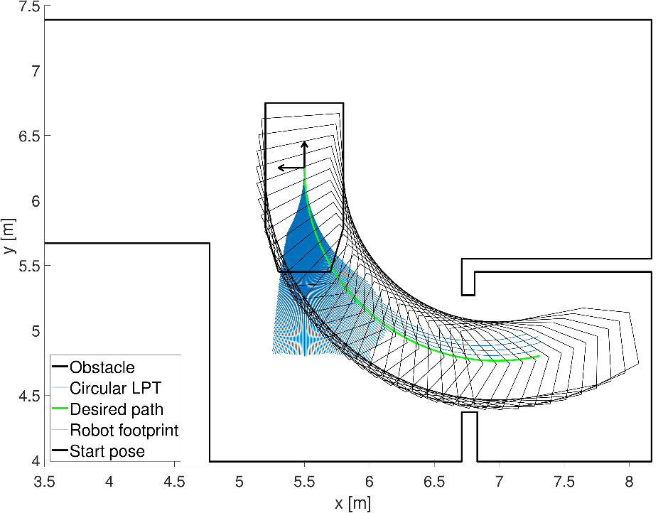
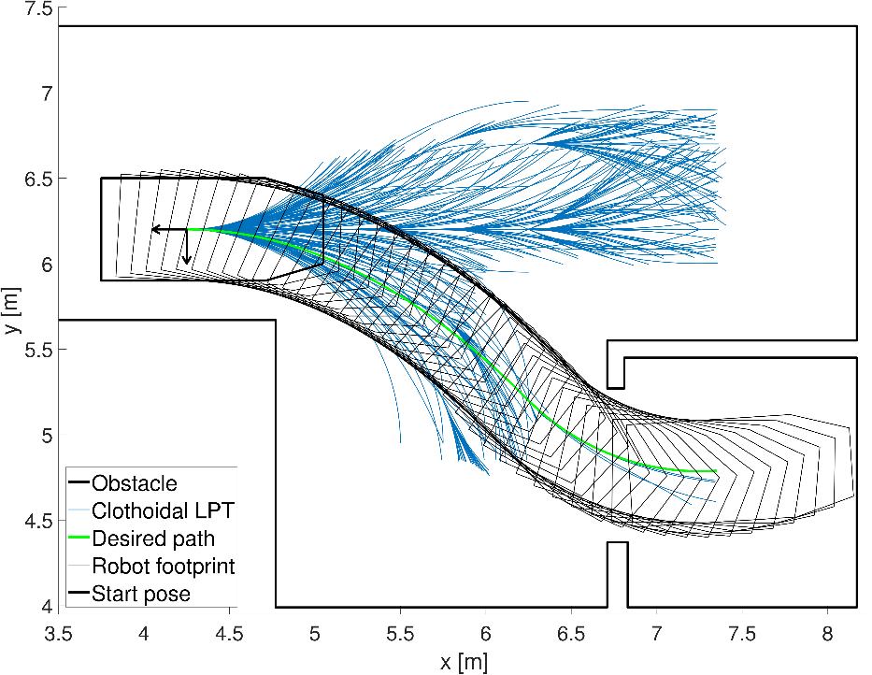
Path Planning Performances
Successful circular LPT
Successful clothoidal LPT
Evaluation of the Developed Local Path Planner
Notes:
These figures show the second scenario for the path planning performances.
Again, two individual successful start poses are shown for both LPT.
The goal is to drive backwards in an elevator, starting from the corridor

Slide 21
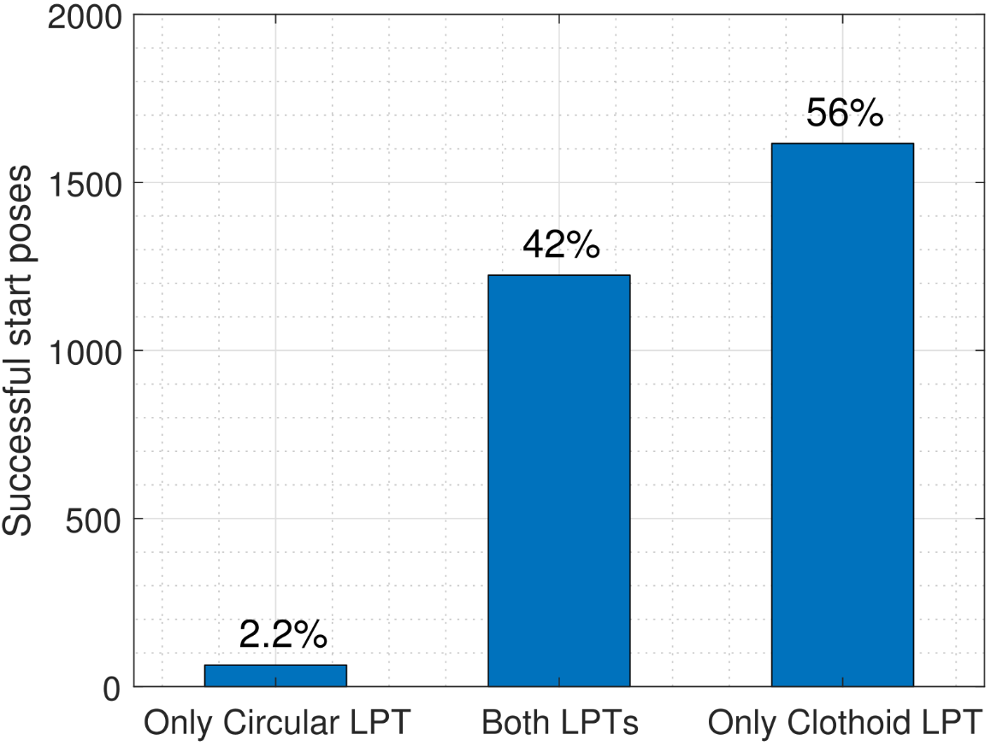
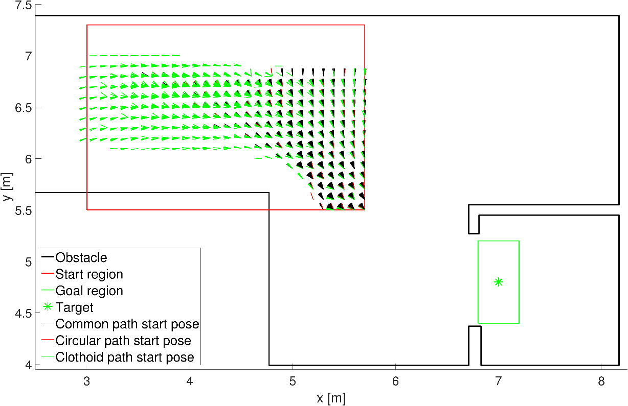
Path Planning Performances
The only LPT able to plan a path from the corridor is the clothoidal LPT.
Clothoidal LPT: 98% successful
Circular LPT: 44% successful
Better assistance to the wheelchair user
Evaluation of the Developed Local Path Planner

Slide 22
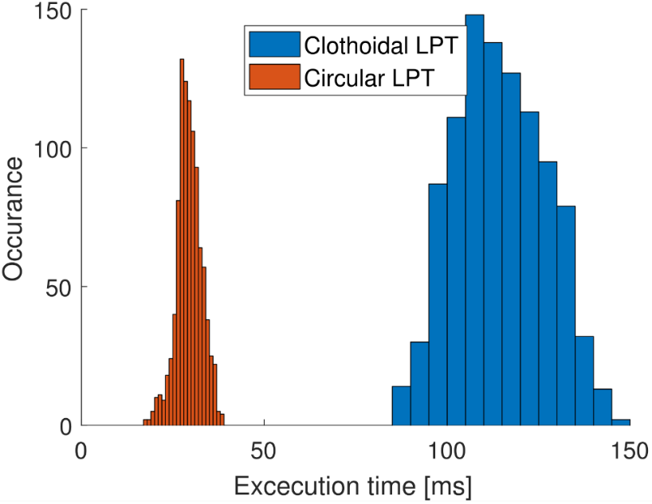
Time Performances
The clothoidal LPT has 6x more paths compared to the circular LPT. Executing time to adjust each path of the LPT in an environment as shown in the planning performances.
Price: 4x longer execution time (30ms vs 120ms)
Simulations performed in MATLAB, faster execution times are expected.
Evaluation of the Developed Local Path Planner
Notes:
It is important to identify the extra time needed to adjust all the paths from Clothoidal LPT.
By using a more flexible curve and complex trajectories, it contains 6x more paths compared to the circular LPT.
The price for flexibility comes with
From the histogram it can be concluded that the of the execution time needed to adapt each path from the LPTs.
The median execution time of the circular LPT is 30 ms compared to 120 ms for the clothoidal LPT; the clothoidal LPT is therefore 3.9 times slower.

Slide 23
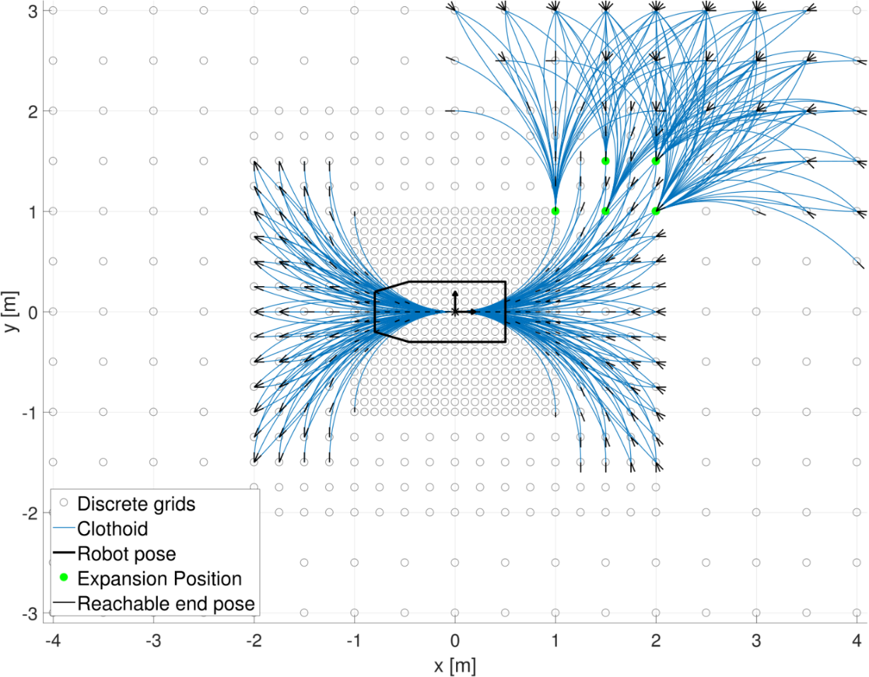
Improvements reducing execution time
Using an asymmetrical LPT:
Location of the Expansion Positions could be dependant on the direction the user wants to take. This will reduce the amount of paths by 2/3. Other possible improvement, decide online where to put the Expansion Positions
Previous user intention: going straight while turning to the left
Evaluation of the Developed Local Path Planner
Notes:
A possible improvement on lowering the execution time can be obtained by using an asymmetrical LPT.
The position of Expansion Positions (green dots) could be dependant on the previous user intention.
If the driver wanted to go straight while turning to the left, expansion position could only be positioned there

Slide 24
Agenda
Introduction
Design of a Local Path Planner
Evaluation of the Developed Local Path Planner
Extension for Dynamic Obstacles
Socially Compliant Path Planning
Future Work and Conclusion
Notes:
Until now, only obstacles where considered as static. Here, a conceptual solution will be presented to include moving obstacles.

Slide 25
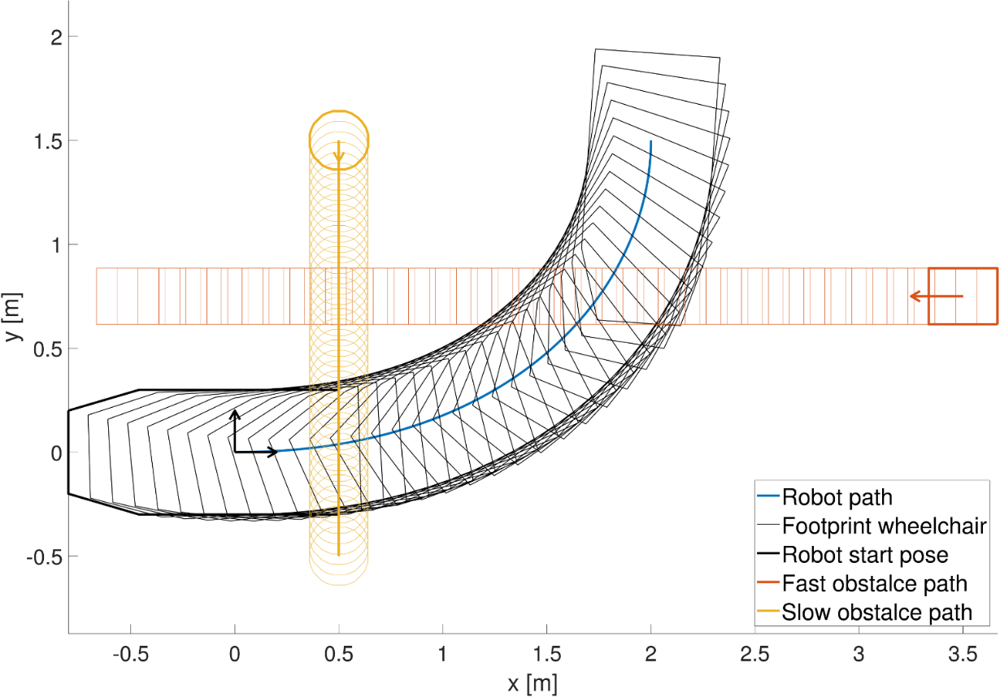
Extension for Dynamic Obstacles
Requirements:
Shape obstacle
Motion model obstacle
While using a fixed path from the LPT, an optimal velocity profile is calculated for a collision-free motion for the robot Takes both kinematic and dynamic constraints into account. Search is performed in an efficient search space, the distance-time collision space.
Extension for Dynamic Obstacles
Notes:
This method assumes a given motion model and shape for every obstacle.
There is however no restriction in shape or motion.
On efficient search space can be created, since only the velocity profile is needed, since the trajectory is fixed.
This will be called the distance-time collision space, since we will analyse at which position on the path the wheelchair will collide with an obstacle at a certain time.
This will be solved as a contraided optimization problem giving the possibility to add both kinematic and dynamic constraints.
A simple mass-damper model will be used to model the wheelchair.
In this example, there will be a fast obstacle, represented by a rectangle going from left to right, and a slower obstacle from top to bottom

Slide 26
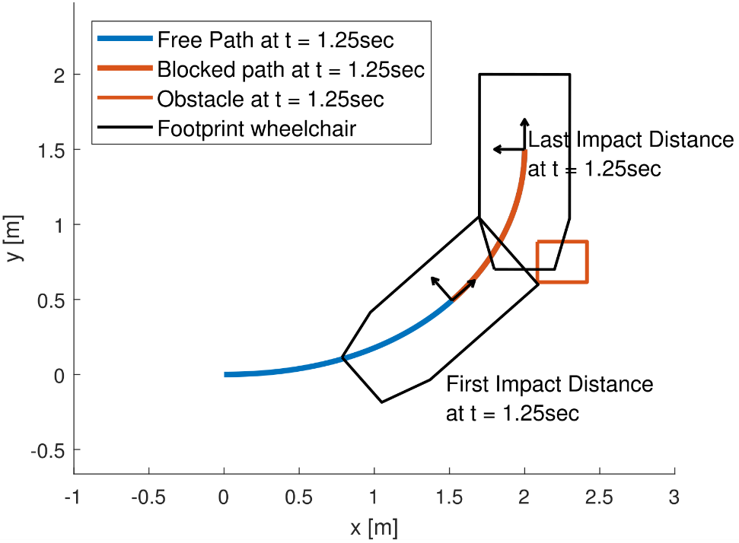
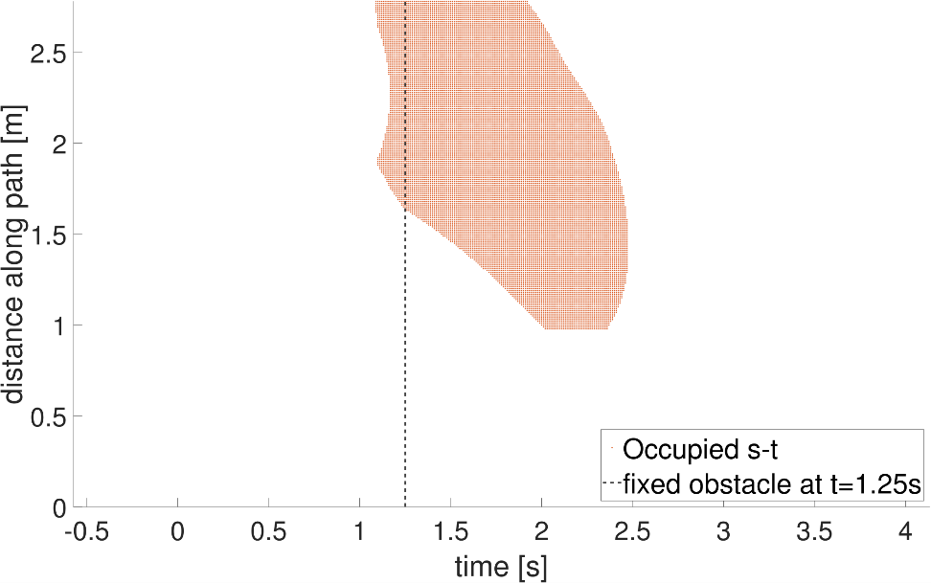
Distance-time collision space
Situation at 1.25 sec
s-t collision grid space
Extension for Dynamic Obstacles
Notes:
The next phase is to construct whole grid, and searching for distance-time pairs which yield a collision.
This will create the an “occupied” grid shown on the left. All the red points indicate a collision in the distance-time space.
I would like to emphasize that the dashed line corresponds to the situation on the left, which is the situation at 1.25 seconds
The path indicated in red corresponds to the dots on the right.

Slide 27
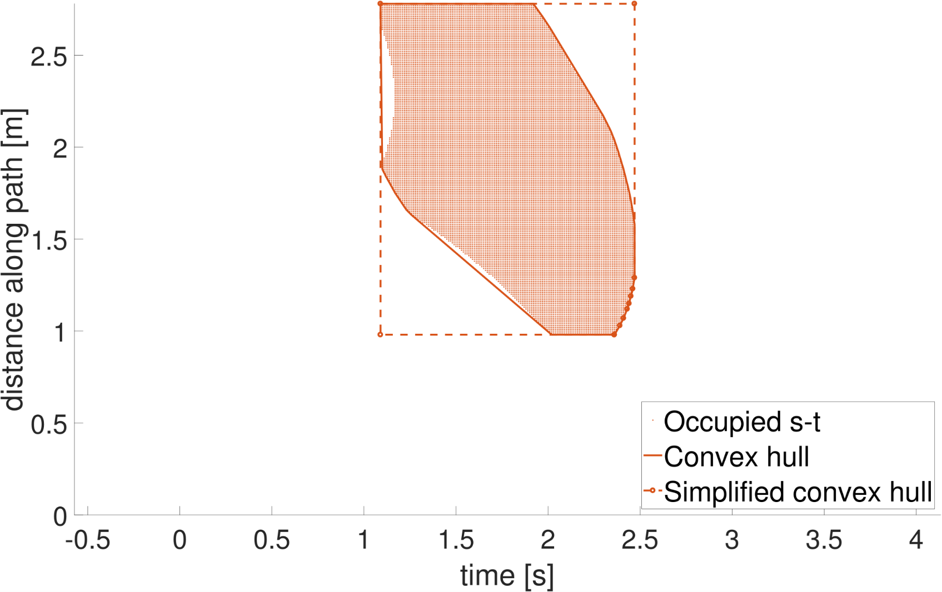
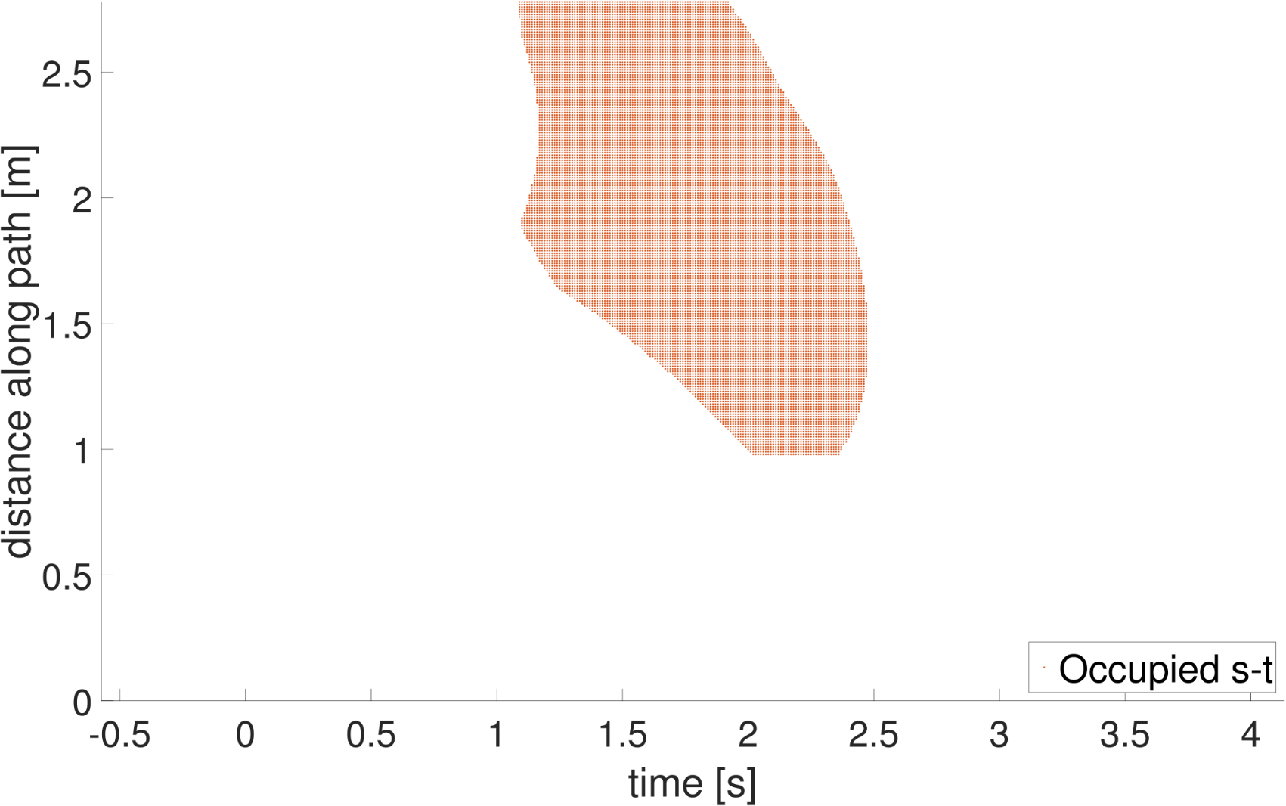
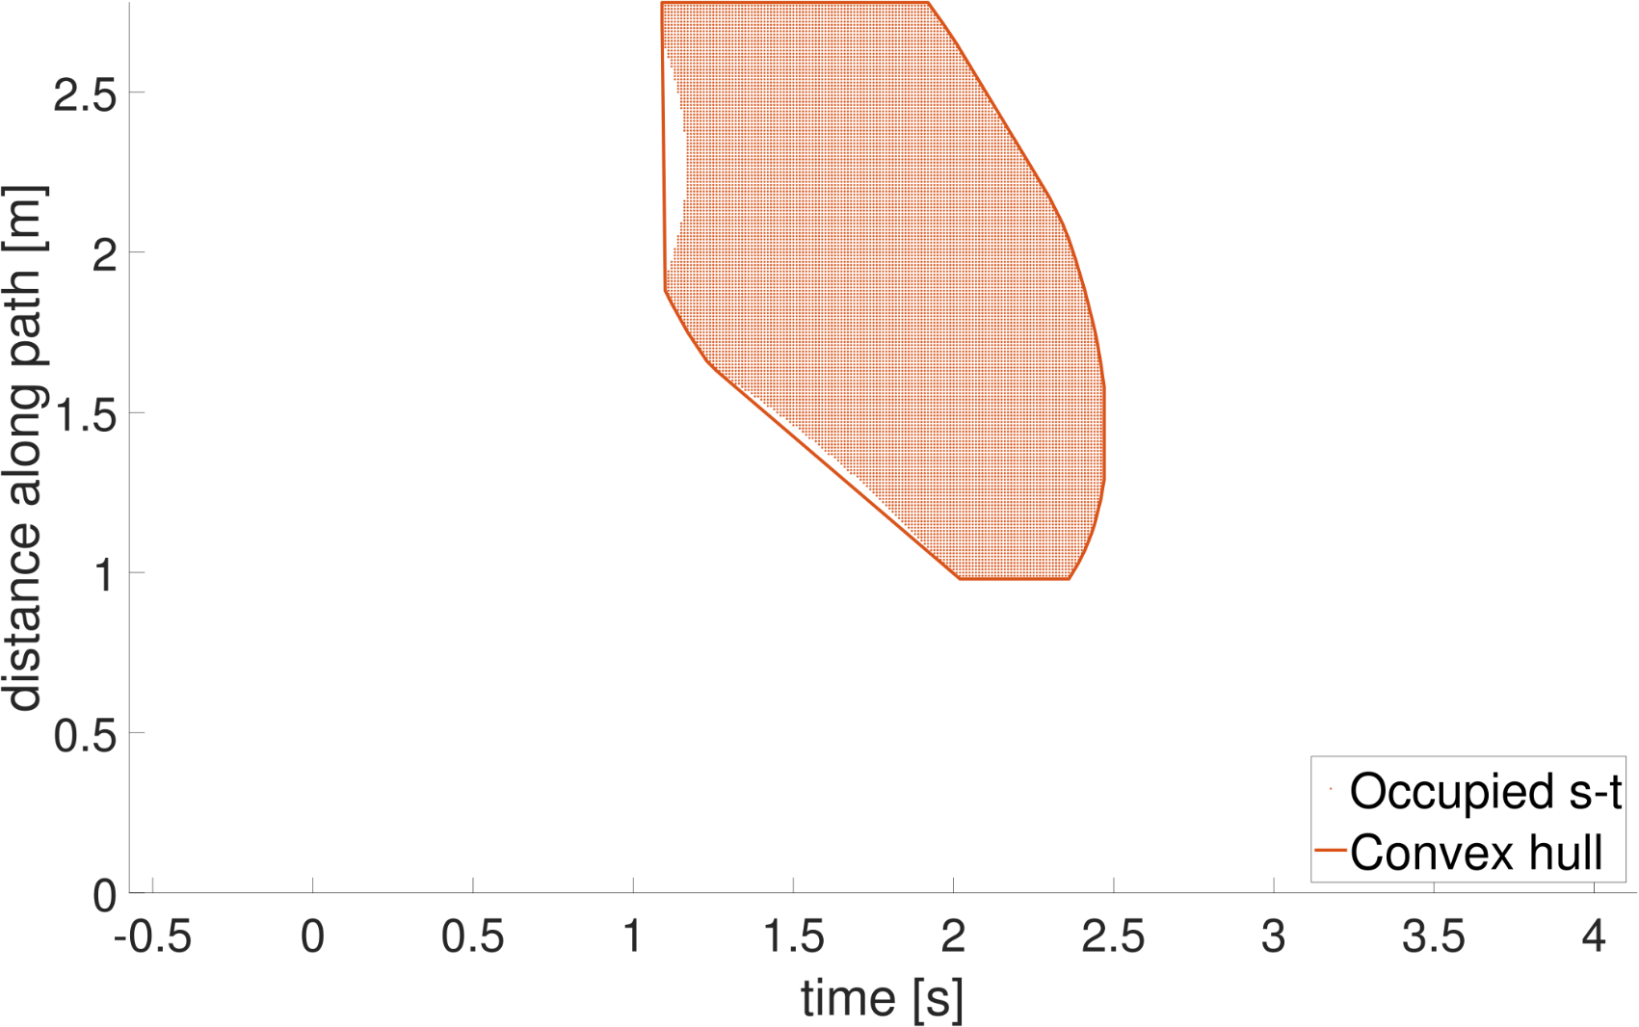
Distance-time collision space
Extension for Dynamic Obstacles
Notes:
This shape can be further optimized in the following way.
Since I will use a classification method to obtain a collision-free velocity profile, I can only keep the convex hull of this shape.
A second simplification can be made by assuming that the robot can only move forward on the path (towards it’s destination) which further simplifies the shape.
In this case, is nearly is a rectangle based on the mimum and maximum distance and time valvues, but this is not always the case

Slide 28
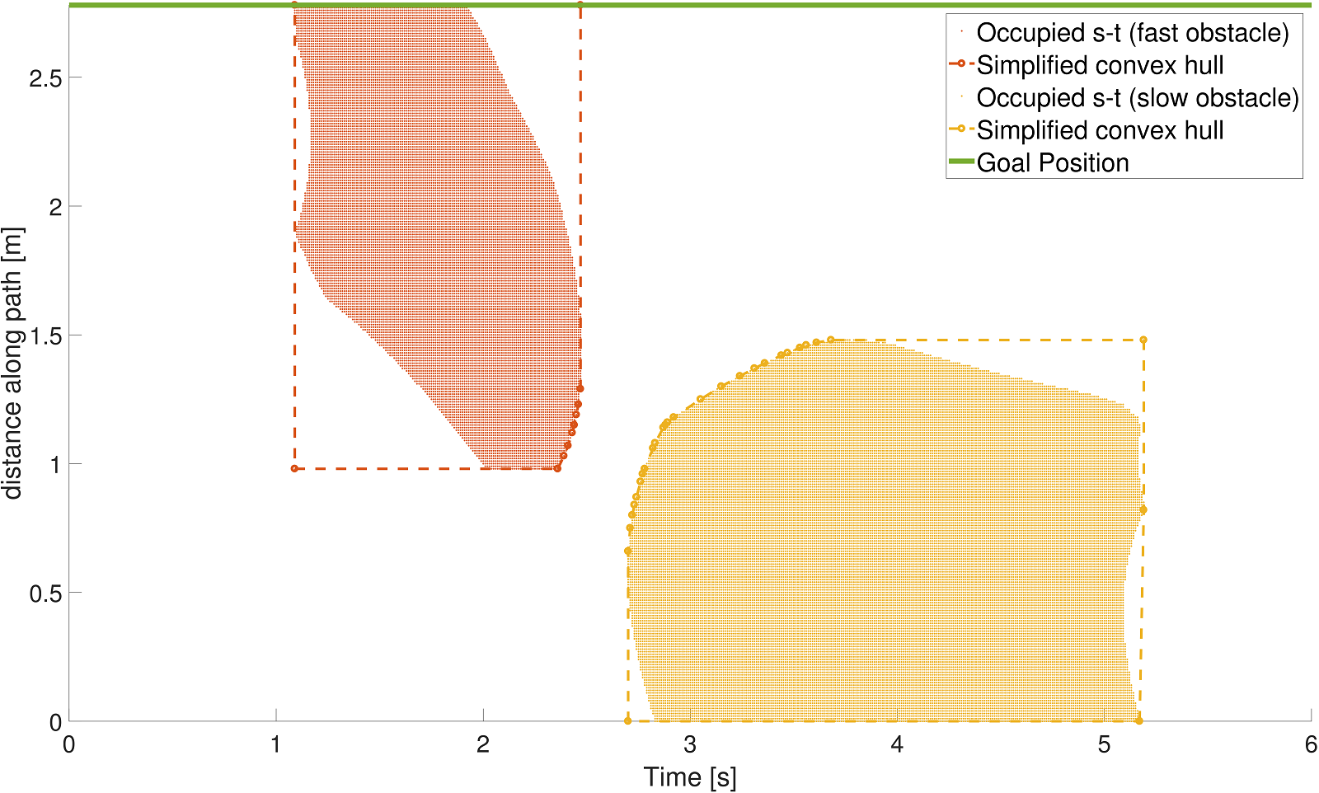
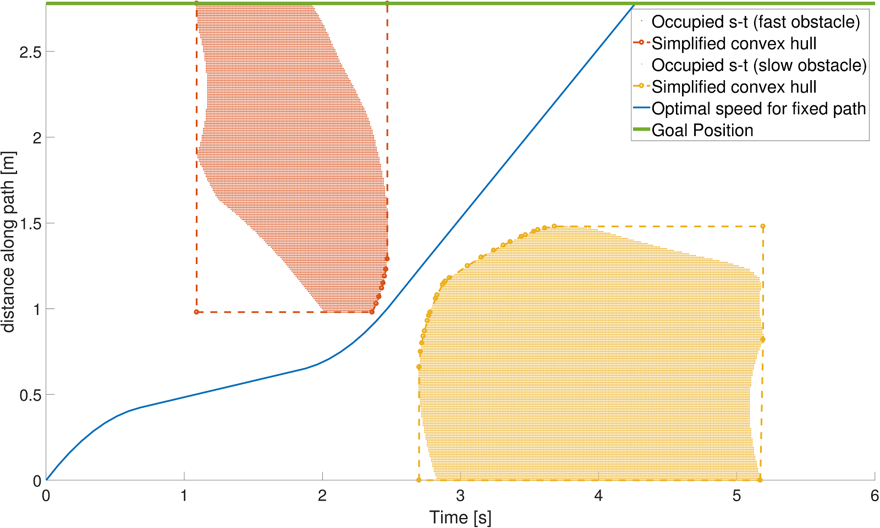
Optimal Velocity Profile for fixed path
Extension for Dynamic Obstacles
Notes:
Here, we can see the same procedure applied for the slower circular obstacle.
Now, a contrainted optimisation problem has to be formulated to enable the planner to go from the origin to the goal position (green line at the top of the figure)
Without colliding this the simplified convex hull and while respecting kinematic and dynamic constrains.

Slide 29
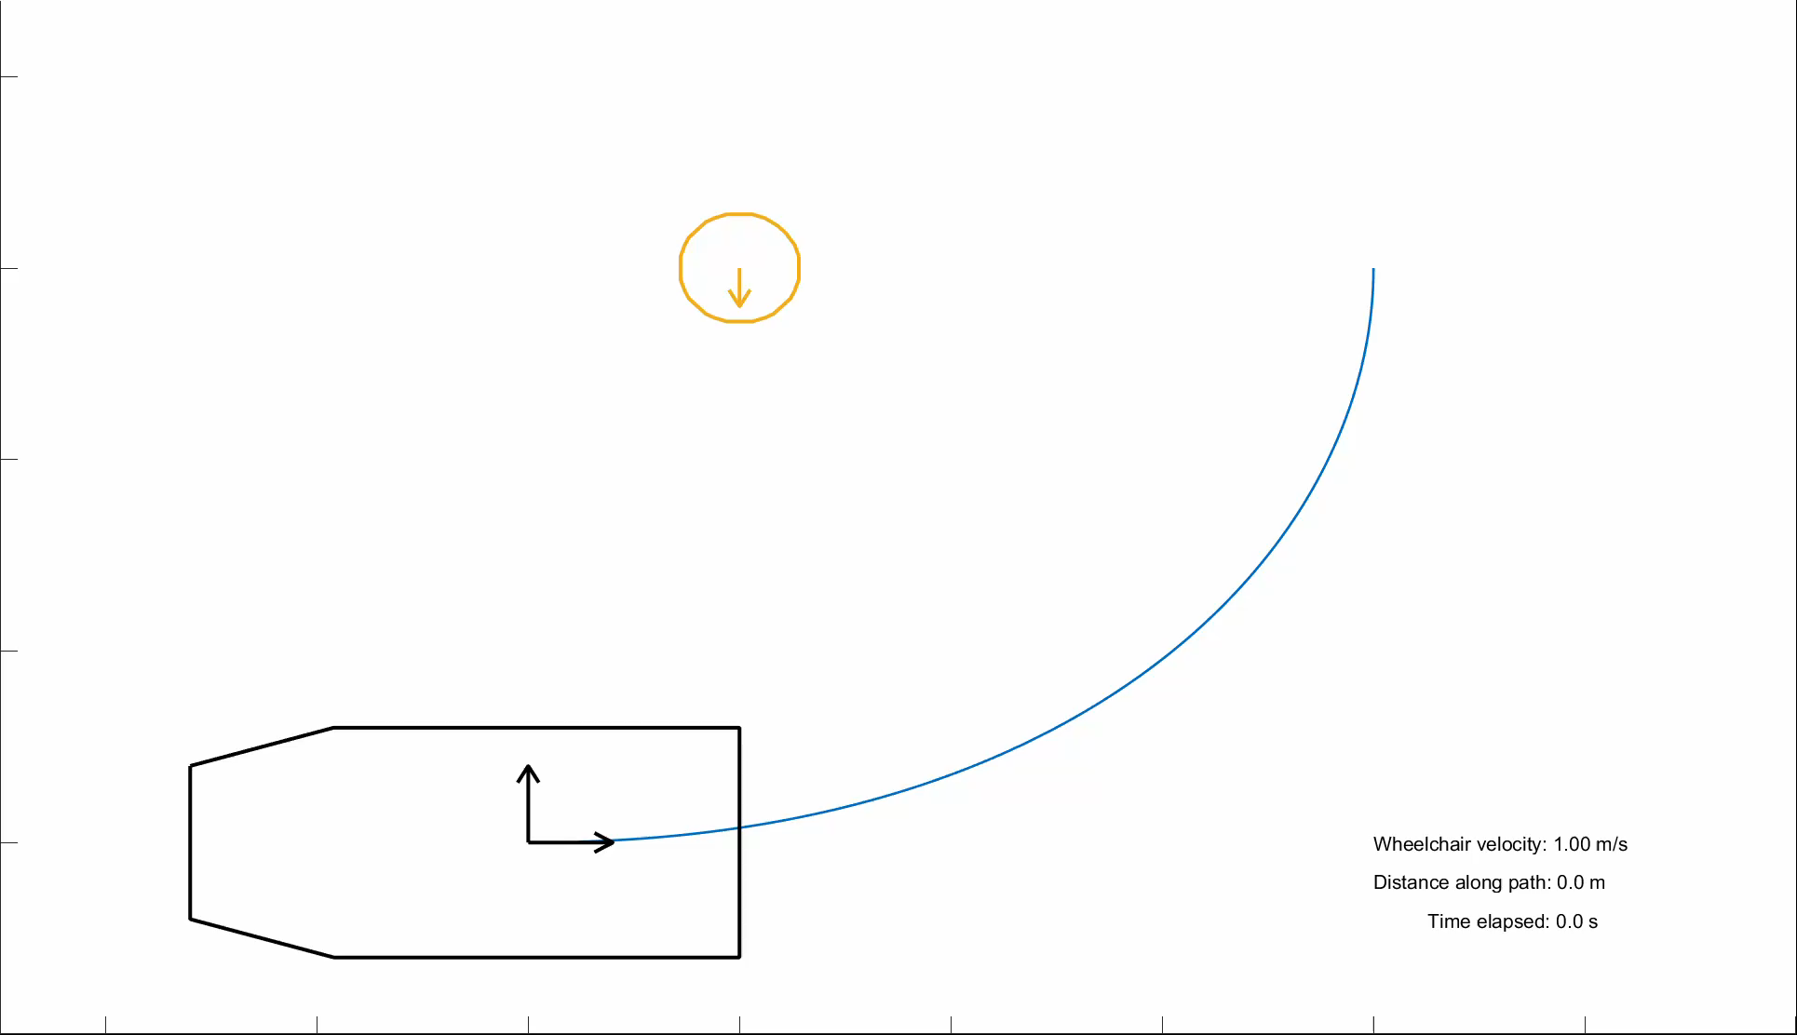
Optimal Velocity Profile for fixed path
Extension for Dynamic Obstacles
Notes:
A small animation to visualize this situation

Slide 30
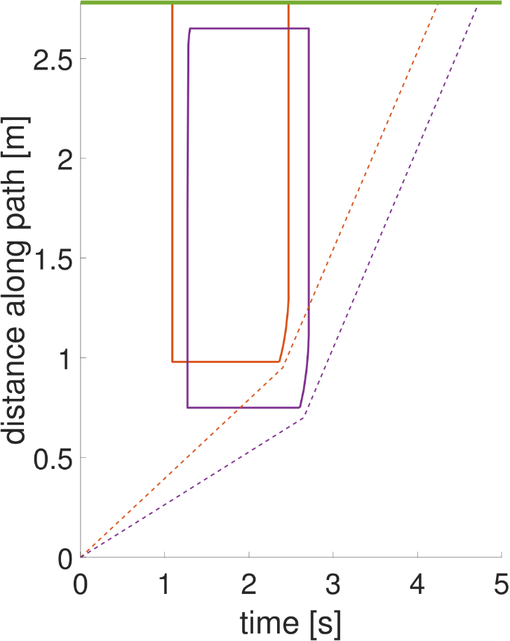
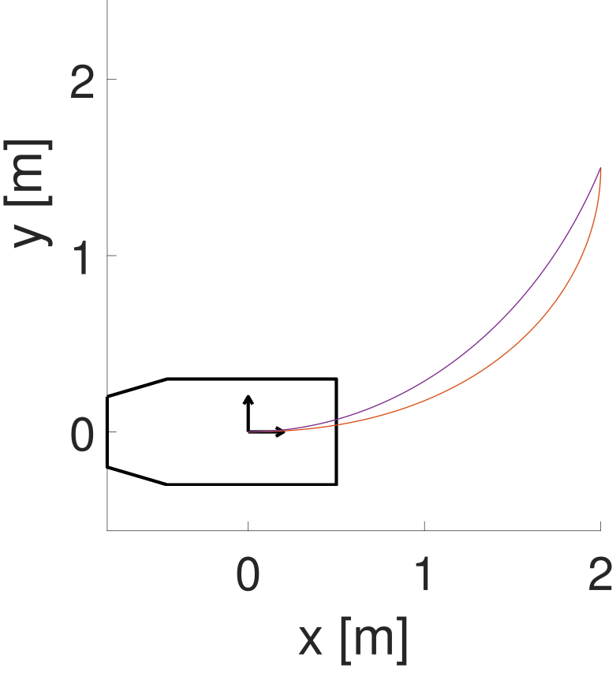
Improve calculation time
Relatively similar paths
Relatively similar solution
Grid search function with replanning capability : D* or Incremental Phi*
Extension for Dynamic Obstacles
Notes:
Another interesting feature of this search space is the relative similarity between to occupied distance time grids of similar paths.
By omitting dynamics, a more efficient grid search function with a replanning capabilities could be used to speed up the calculation.

Slide 31
Agenda
Introduction
Design of a Local Path Planner
Evaluation of the Developed Local Path Planner
Extension for Dynamic Obstacles
Socially Compliant Path Planning
Future Work and Conclusion
Notes:
In this part, guidelines will be presented to create a socially compliant the local path planner.
These methods are compatible with the local path template method, but where not formally implemented.

Slide 32
Human-Aware Robot Navigation
Combines the field of human-robot interaction and robot motion planning.
Fields of research according to the survey by Kruse et Al. :
Comfort: safety, avoiding stress, annoyance
Naturalness: jerkless motion, legible
Sociability: cultural conventions, other social protocols
Socially Compliant Path Planning
Notes:
Human aware robot navigation is a new field in the robotics.
It combines the field of human-robot interaction and robot motion planning.
From the survey performed by Kruse, 3 main field of research are defined
Comfort : The robot should not cause any stress or annoyance to the humans interacting with it.
Naturalness: which is obtained by having a jerkless motion and by performing legible (readable) action.
Sociability, which includes cultural conventions (e.g. lane side right/left) and other social protocols.

Slide 33
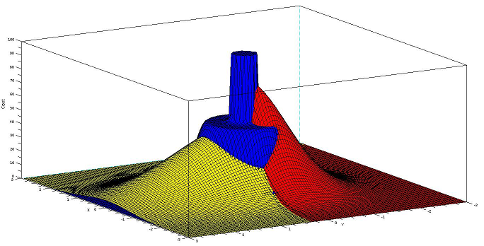
Dynamic Personal Space
Path planner can inherently take into account the “social cost” of a particular path.
Similar to the user’s intention ⬄ caused discomfort
Cost map reflecting dynamic personal space developed by Scandolo and Fraichard.
Starting point of this model: the proxemics rules studied by Edward T. Hall (1966) → blue area
Additions to reflect the influence of movement: Red area (orientation dependent, “back space”) Yellow area (speed and orientation dependent, “Personal Space during Motion”)
Socially Compliant Path Planning
Notes:
The impact on the comfort of humans in the surrounding of the wheelchair is an important consideration even though the wheelchair is still guided by a person.
When choosing a path from the template, we can consider it’s similarity to the user’s intention but also the caused discomfort.
A cost map model reflecting the dynamic personal space has been developed by Scandolo and Fraichard,
which is based on the proxemics rules by Edward T. Hall, shown in blue (the closer the robot is to a person, the higher the cost.
They have expanded this static rules by adding two dynamic factors :
The additional discomfort by driving behind someone where he can’t see the wheelchair shown in red
And the discomfort caused by driving just in front of someone who is walking shown in yellow

Slide 34
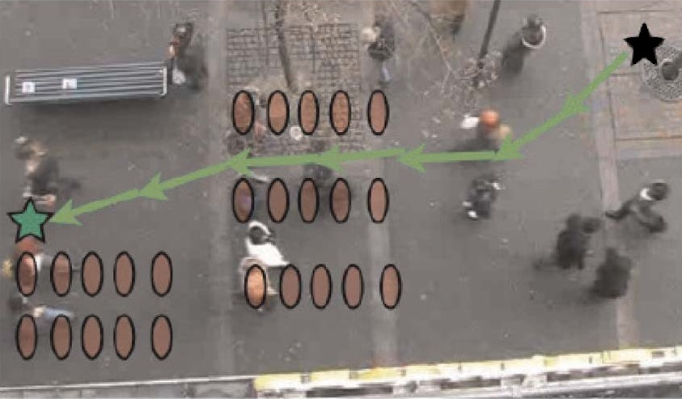
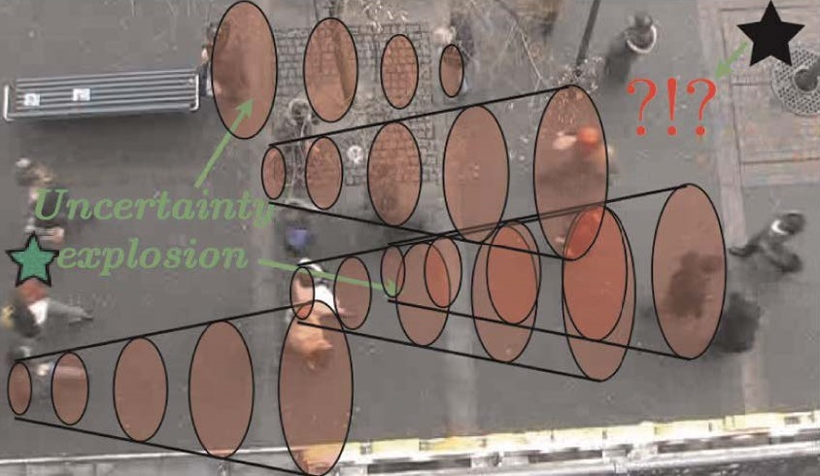
Human-Robot Cooperation Model
Socially Compliant Path Planning
Notes:
Research lead by Trautman investigates causes of the Freezing Robot Problem when the robot has to plan a path in a dynamic environment.
This occurs the robot suddenly stops or ever worse, try to perform dangerous evasive maneuvers because it can’t make an appropriate decision based on his surroundings.
On this picture, we see that the robot (black star) is unable to plan a path towards the goal (green star).
A possible explanation is due to the uncertainty explosion of the motion model of the moving agents.

Slide 35
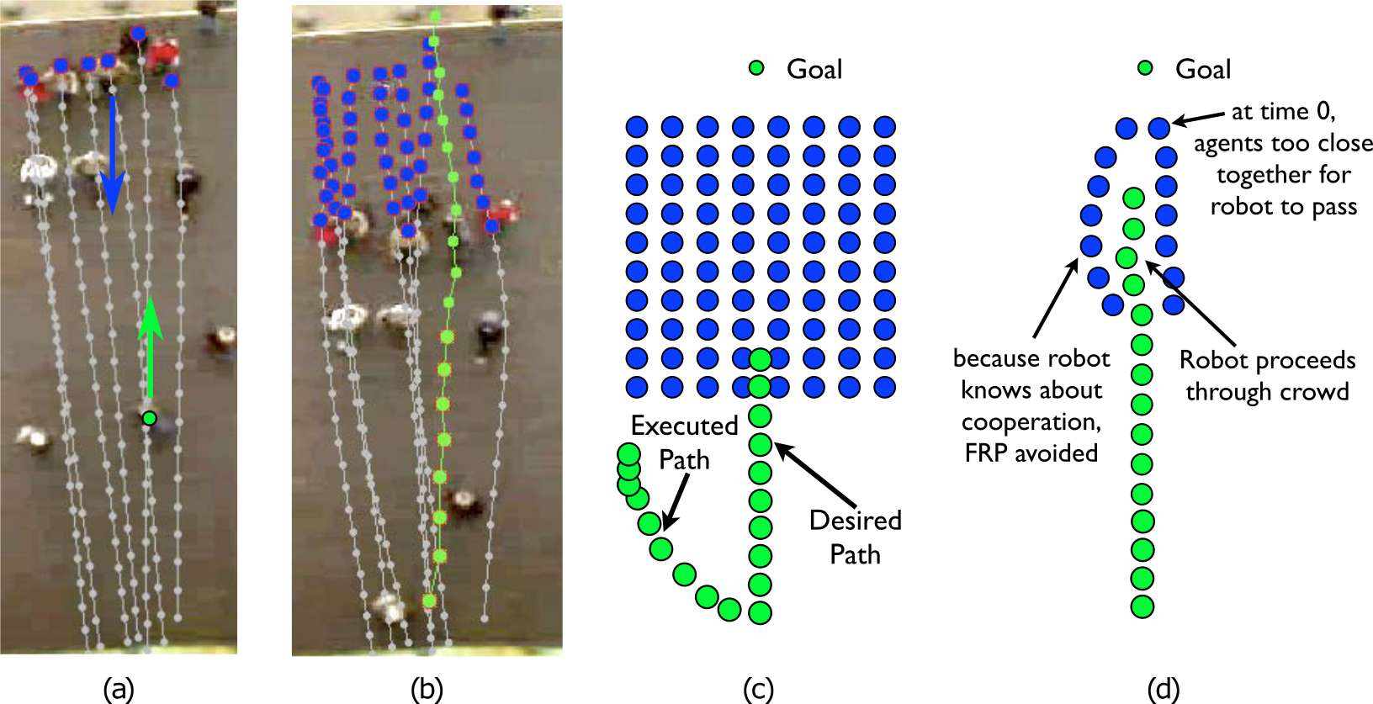
Human-Robot Cooperation Model
Socially Compliant Path Planning
Notes:
However, from the moment the crowd is more numerous or adopts a complex formation (e.g. shoulder to shoulder walking) each independent navigation planner is bound to fail.
In this cause, even with perfect motion prediction the robot will try to pass around this formation.
Trautman has then investigated with empirical data how we, humans, achieve such a shoulder to should formation without colliding with each other.
He has noted that we perform a “joint collision avoidance scheme”. Each one of the walking persons eventually adapts it’s path such that everyone can arrive at it’s destination.
The group of people in blue, at the top, adapt their path for the green person going up.
Their research have captured this cooperation in a Interacting Gaussian Process Model. Using this model, they achieved the first successful large scale study on navigation in dense human crowds.

Slide 36
Agenda
Introduction
Design of a Local Path Planner
Evaluation of the Developed Local Path Planner
Extension for Dynamic Obstacles
Socially Compliant Path Planning
Future Work and Conclusion
Notes:
Let’s wrap up this presentation with possible future work and concluding remarks

Slide 37
Future Work
Better placement of the Expansion Position will reduce the computational time needed to adjust each path length.
Faster dynamic motion planner by using a grid search planner.
Implementation of human-aware navigation.
Future Work and Conclusion

Slide 38
Conclusion
Expanded the current planner based on circular arcs with a more flexible curve geometry based on clothoids.
This improvement on path planning performance comes with a cost, the time needed to adapt each path length.
Conceptual solution taking into account moving obstacle by calculating a collision-free speed profile for a fixed path.
Future Work and Conclusion
Notes:
I have contributed to the ongoing research on Wheelchair Navigation Assistance by :

Slide 39
End of the presentation
Thank you for your kind attention
Notes:
Thank you for your kind attention
Demeester, Bruyninckx, Johan
For their guidance during my thesis-journey

Slide 40
Possible improvements to the Local Path Planner
Improving user’s intention estimation by widening the range of possible paths.
Capacity of the LPP to calculate efficiently more complex paths to assist a wider range of maneuvers.
Plan a path taking into account dynamic obstacles.
Human-aware path planning.
Impact of castor wheels on at the start of the path.
Dealing with uncertainties (path execution, discretisation).
Introduction
Notes:
There are other improvements that can be made to the Local Path Planner,
Next to offering a wider range of complex paths,
the current planner doesn’t take into account dynamic obstacle, it considers everything as static, which can lead to possible collisions.
By adding the notion of human aware navigation we can obtain a more socially compliant path planner.
The impact of the orientation of the castor wheels (free wheels which rotate freely, which stabilizes the wheelchair) since they have a large impact on the motion when not oriented with the desired trajectory.
The uncertainty on a executed path can also be taken into account offering a more robust navigation
I will address the first 4 points will be addressed during this presentation.

Slide 41
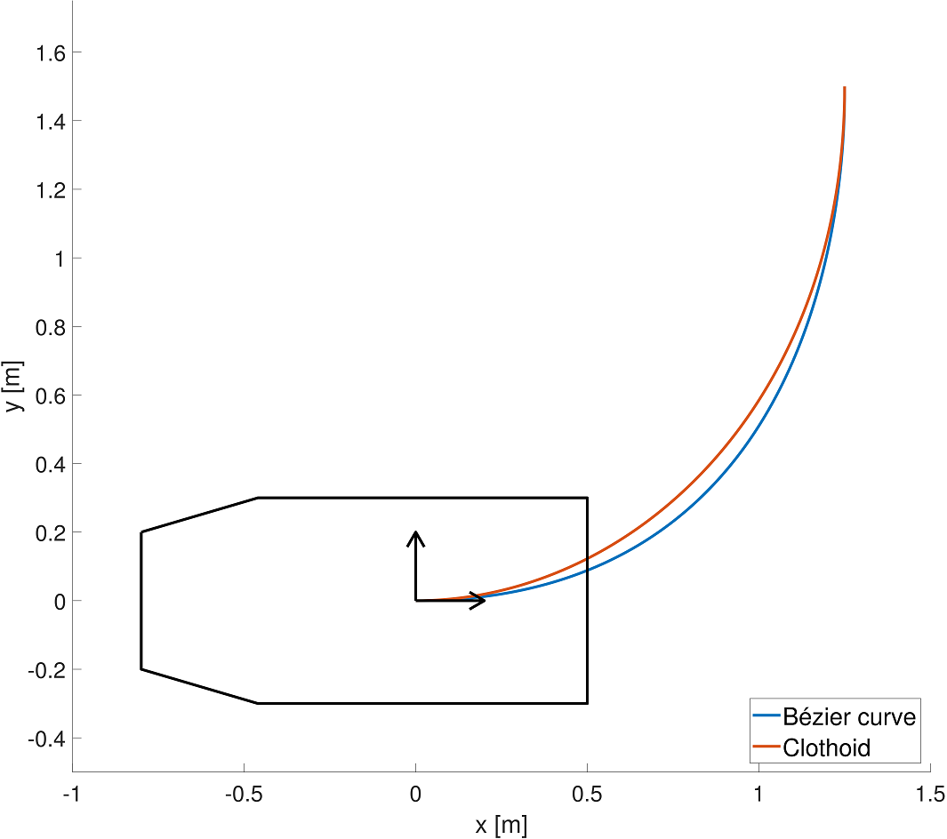
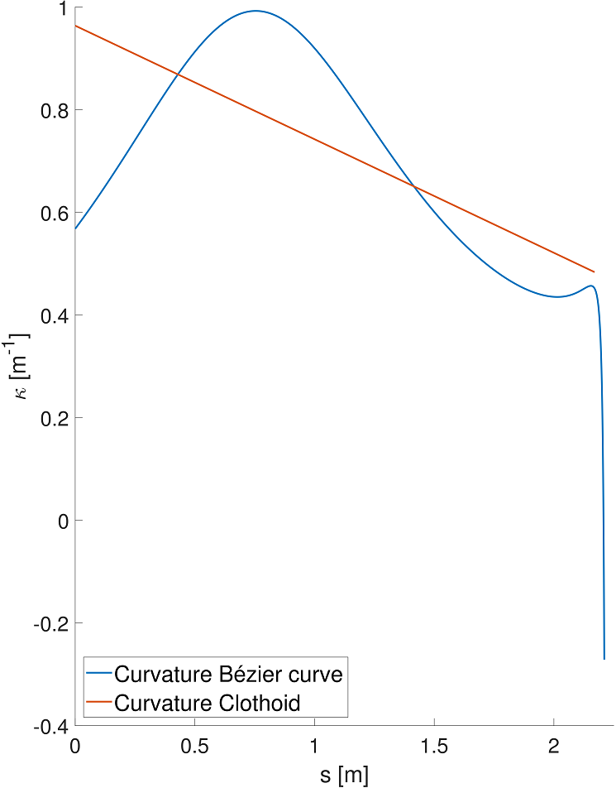
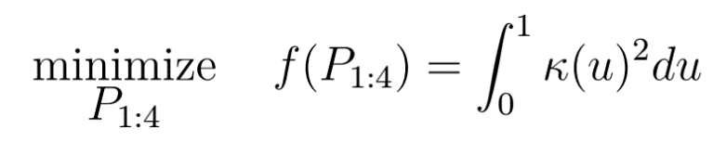
Selection of curve geometry
Common start-end pose
Curvature
Design of a Local Path Planner

Slide 42
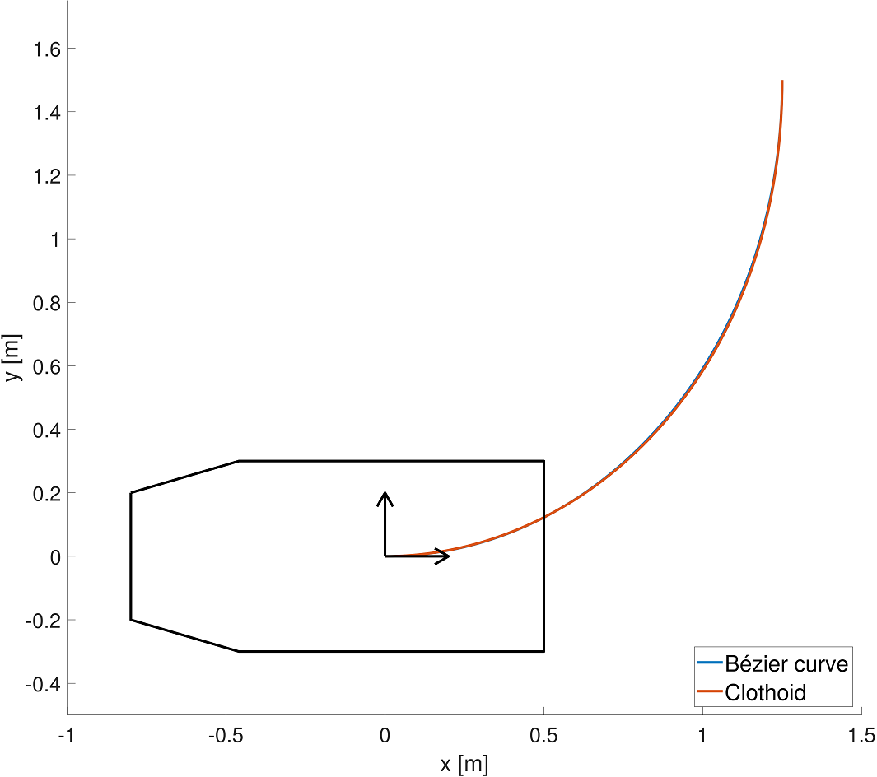
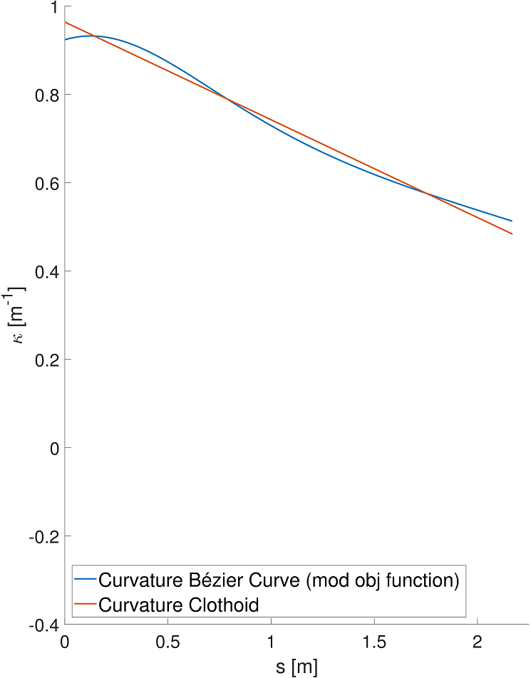
Selection of curve geometry
Common start-end pose
Curvature
Design of a Local Path Planner

Slide 43
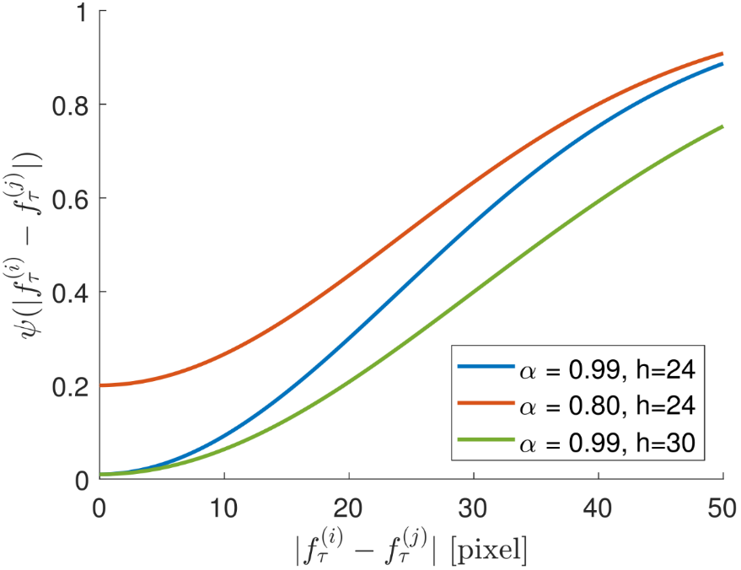
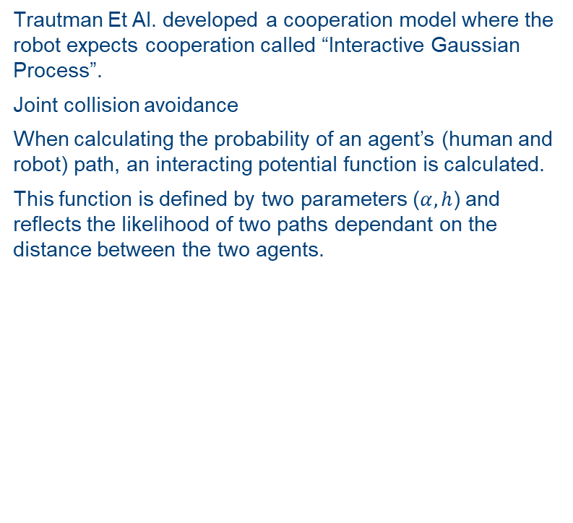
Human-Robot Cooperation Model
Trautman Et Al. developed a cooperation model where the robot expects cooperation called “Interactive Gaussian Process”.
Joint collision avoidance
When calculating the probability of an agent’s (human and robot) path, an interacting potential function is calculated.
This function is defined by two parameters ($α,h$) and reflects the likelihood of two paths dependant on the distance between the two agents.
Literature Study
Notes:
Influence of the two defining parameters for interaction potential between agent $i$ and $j$ at time instant $\tau$}{defined by \cref{eq:InterPotFunc}. ($\alpha$ and $h$) and is dependent on the (instantaneous) Euclidean distance between the two agents. This function lowers the probability that agent $i$ and $j$ are too close to each other at a given time instance $\tau$, reflecting the joint collision avoidance nature of humans. The distance is specified in pixels as an overhead camera was used during the experiments (adapted from \cite{TrautmanKrause2010}).\label{fig:InteractionPotentialFunction}}
Humans typically solve this problem by forming a “joint collision avoidance” scheme, where every agent adapts
his path according to the surroundings to allow passage for everyone. Therefore, the
authors redefined the ill-formulated independent path planner to explicitly expect
cooperation from humans. Their method, named Interactive Gaussian Process,
models the robot as part of the human crowd, and expects that all agents adapt
their path so that everyone can reach their destination.
robust navigation scheme when navigating in dense crowds and
will therefore solve the FRP typically occurring in this type of environment.

Slide 44
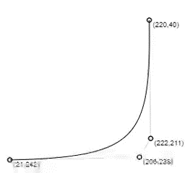
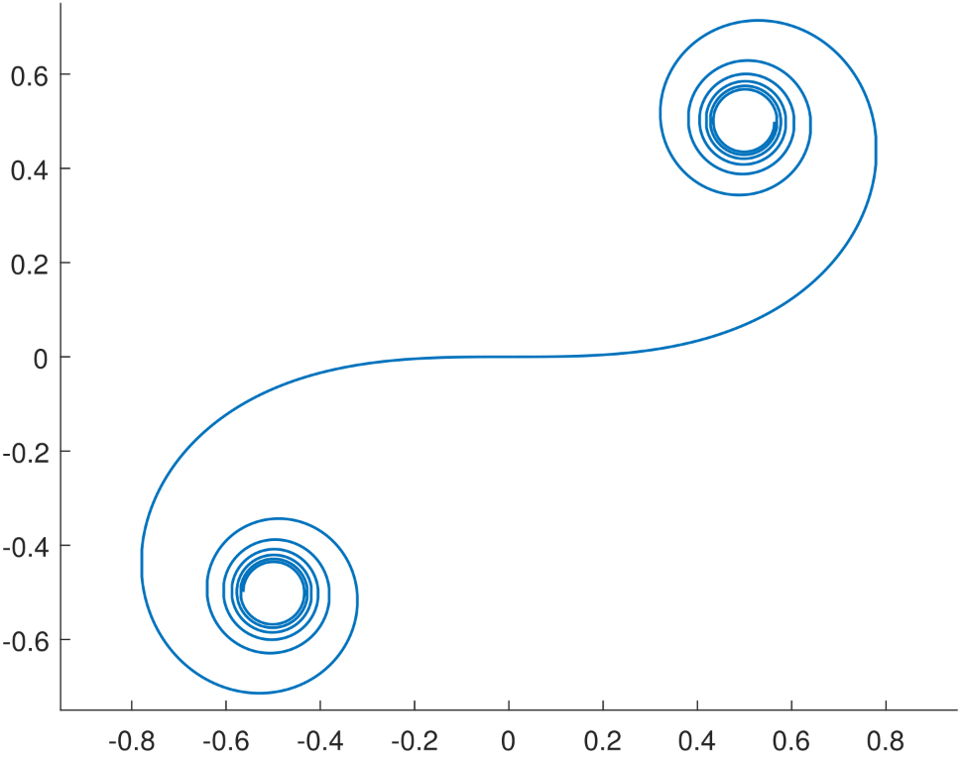
Two possible curve geometries
Bézier curve
Clothoid
Design of a Local Path Planner

Slide 45
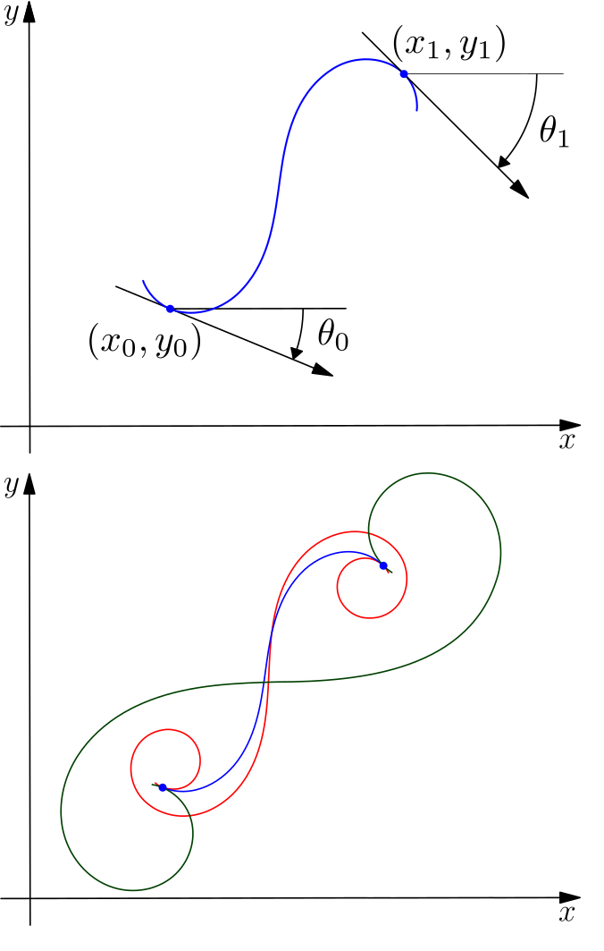
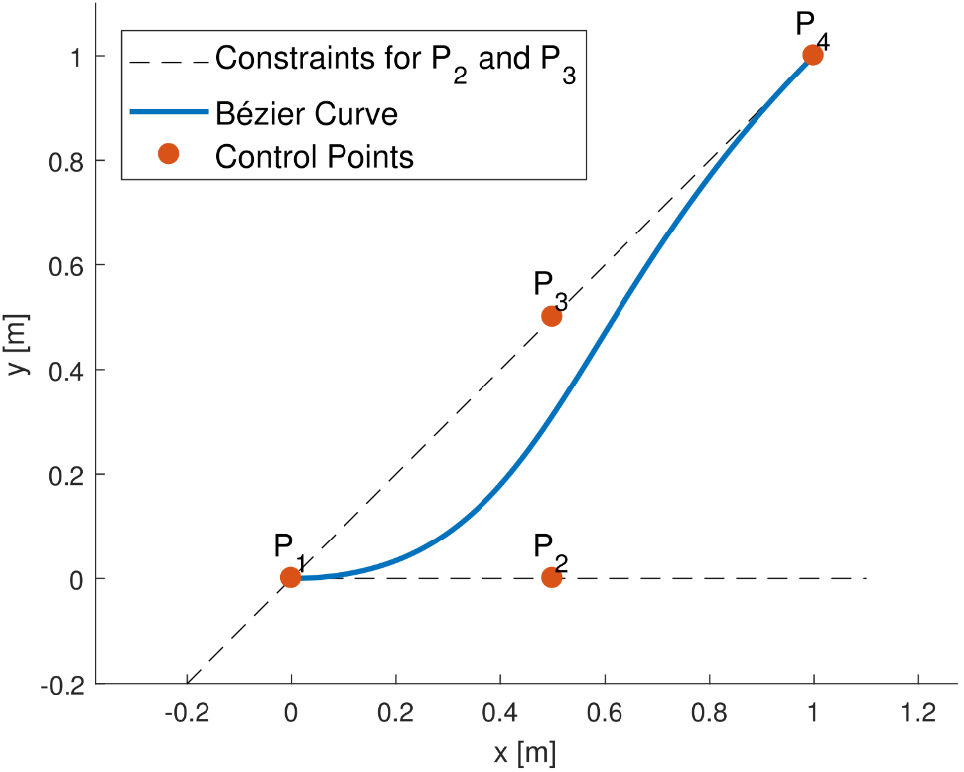

G1 Fitting with the curve geometries
Bézier curve
Clothoid
Design of a Local Path Planner

Slide 46


Resulting Motion Primitives
Bézier curve
Clothoid

Slide 47

Selection of curve geometry
Possible selection criteria:
Unique end poses achieved by curve geometry ?
Design of a Local Path Planner

Slide 48

Selection of curve geometry
Better selection criteria:
Actuator “effort” needed to follow a common start-end pose

Slide 49
Selection of curve geometry
Common start-end pose
Curvature
Design of a Local Path Planner

Slide 50



Slide 51
Literature Study
Systematic method to create a set of kinematically feasible paths
Methods used to plan a path in a dynamic environment
Human-aware robot navigation
Socially Compliant Path Planning
Human-robot cooperation model
Literature Study

Slide 52

State Lattice Search Space
Research of Pivtoraiko and Kelly
Focussing on the global path planning
Novel search space: State Lattice
Takes explicitly kinematic constraints of the robot in the creation of Motion Primitives
Motion primitives are then spread over the search space to create the state lattice
Systematic method to generate the a set of Motion Primitives
Literature Study

Slide 53
Optimal Motion Generation
OMG-tools created by research group MECO (Van Parys and Mercy)
Finding an optimal trajectory between a start and end position involves : 1. Geometric, kinematic and dynamic constraints along with obstacle avoidance 2. Constraints should be respected during the whole motion. 3. Uncertainty on the perceived environment.
Used methodology to address those challenges : 1. B-spline parametrization 2. Separating hyperplanes along with motion model estimation 3. Motion trajectory should be continuously updated using the most recent world information
Literature Study
Notes:
Particularly well suited for the use in autonomous systems. Less adapted when user’s intention is unknown and must be continuously estimated.
Method used for dynamic obstacle is inspired on this method, whilst using a fixed trajectory

Slide 54


Distance-time collision space
Collision Time (obstacle)
Collision Distance (robot)
Extension for Dynamic Obstacles
Notes:
First step is to reduce the search space.
This is done by a quick analysed :
When is the fist and the last time the obstacle collides with the path occupancy grid of the wheelchair ?
When is the first and last distance along the fixed path when the wheelchair collides with the moving obstacle ?

Slide 55


Constrained Optimization Problem Formulation
Extension for Dynamic Obstacles
Notes:
The objective function is to arrive at the end of the path in minimal amount of time, while trying to loose as less as possible speed.
This is done with the second term of the goal function.
The second term will not influence the arrival time, it only forces the solution to break ass least (this will become clear in the next slide).
The state of the robot is defined by its position along a path and it’s speed, and is obtained by integrating a simple mass-damper model.
To enforce the path not to overlap with the occupied distance-time shape, a classification method is used, based on hyperplanes (in 2D this results in a simple line).
At each discrete time instance, a line has to be drawn separating all the vertices on one side, from the current state of the motion. This has to be done for each obstacle.
Start conditions on the state are added, along with the end-state for the position (end of the path)
A limit on the maximum velocity and force on the wheelchair can be implemented

